Slide 1
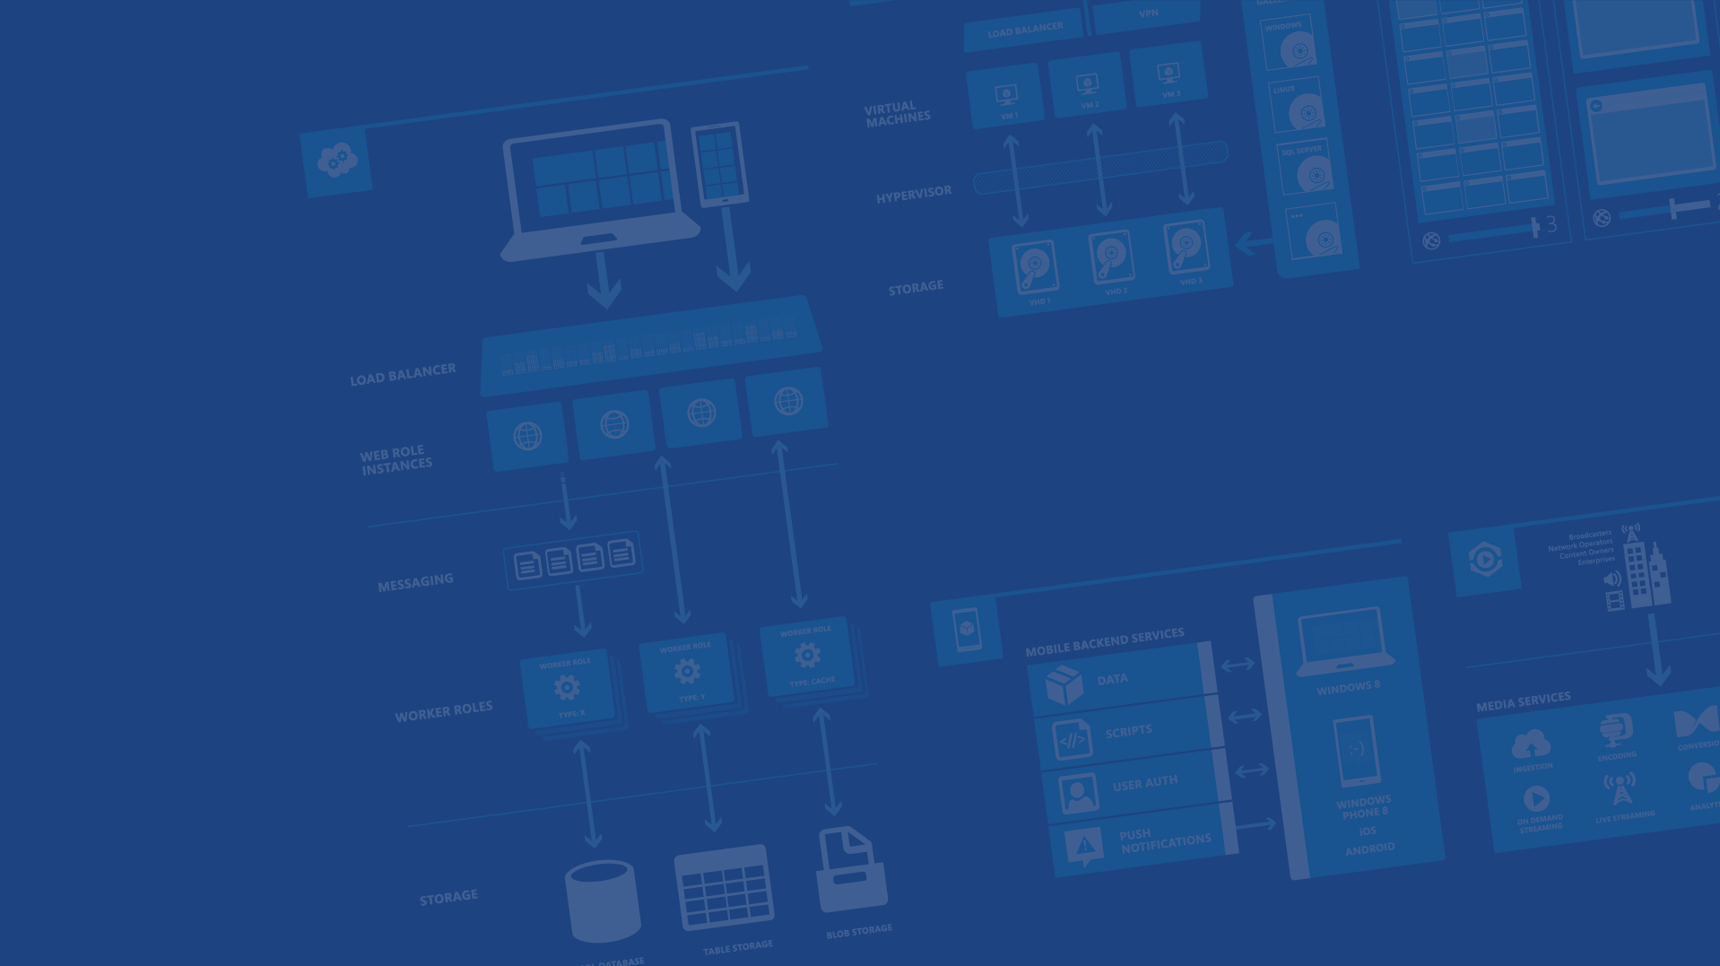
Polyglot Persistence in Microsoft Azure
Presenter Name
Charalampos Karypidis
Freelance Software Engineer .NET - JavaScript
@xabikos
Microsoft Azure

Slide 2
Agenda
Blobs
Redis Cache
Tables
SQL Databases
Queues
DocumentDB

Slide 3


Microsoft Azure Data Services
SQL Server in a VM
SQL Database
DocumentDB
Tables
Blobs
fully managed, scalable, queryable, schemafree JSON document database service for modern applications
fully featured RDBMS
transactional processing
rich query
managed as a service
elastic scale
schema-free data model
internet accessible http/rest
arbitrary data formats

Slide 4
Microsoft Azure Storage Blob

Slide 5
Two Types of Blobs Under the Hood
Block Blob Page Blob
Notes:
Slide Objective
Understand that there are two blob types

Slide 6
Block Blob
Targeted at streaming workloads
Each blob consists of a sequence of blocks
Each block is identified by a Block ID
Size limit 200GB per blob
Optimistic Concurrency via Etags
Notes:
Slide Objective
Understand block blob
Speaker Notes
Block blobs are comprised of blocks, each of which is identified by a block ID.
You create or modify a block blob by uploading a set of blocks and committing them by their block IDs.
If you are uploading a block blob that is no more than 64 MB in size, you can also upload it in its entirety with a single Put Blob operation.
When you upload a block to Microsoft Azure using the Put Block operation, it is associated with the specified block blob, but it does not become part of the blob until you call the Put Block List operation and include the block's ID.
The block remains in an uncommitted state until it is specifically committed. Writing to a block blob is thus always a two-step process.
Each block can be a maximum of 4 MB in size. The maximum size for a block blob in version 2009-09-19 is 200 GB, or up to 50,000 blocks.
Notes
http://msdn.microsoft.com/en-us/library/dd135734.aspx

Slide 7
Page Blob
Targeted at random read/write workloads
Each blob consists of an array of pages
Each page is identified by its offset from the start of the blob
Size limit 1TB per blob
Optimistic or Pessimistic (locking) concurrency via leases
Notes:
Slide Objective
Understand page blob
Speaker Notes
Page blobs are a collection of pages.
A page is a range of data that is identified by its offset from the start of the blob.
To create a page blob, you initialize the page blob by calling Put Blob and specifying its maximum size.
To add content to or update a page blob, you call the Put Page operation to modify a page or range of pages by specifying an offset and range. All pages must align 512-byte page boundaries.
Unlike writes to block blobs, writes to page blobs happen in-place and are immediately committed to the blob.
The maximum size for a page blob is 1 TB.
A page written to a page blob may be up to 1 TB in size but will typically be much smaller
Notes
http://msdn.microsoft.com/en-us/library/dd135734.aspx

Slide 8
Blob Storage Concepts
http://{account}.blob.core.windows.net/{container}/{blobname}
Account
Container
Blob
Pages/Blocks
PIC01.JPG
images
Block/Page
PIC02.JPG
contoso
Block/Page
videos
VID1.AVI
Notes:
Slide Objectives
Understand the hierarchy of Blob storage
Speaker Notes
The Blob service provides storage for entities, such as binary files and text files.
The REST API for the Blob service exposes two resources:
Containers
Blobs.
A container is a set of blobs; every blob must belong to a container.
The Blob service defines two types of blobs:
Block blobs, which are optimized for streaming.
Page blobs, which are optimized for random read/write operations and which provide the ability to write to a range of bytes in a blob.
Blobs can be read by calling the Get Blob operation. A client may read the entire blob, or an arbitrary range of bytes.
Block blobs less than or equal to 64 MB in size can be uploaded by calling the Put Blob operation.
Block blobs larger than 64 MB must be uploaded as a set of blocks, each of which must be less than or equal to 4 MB in size.
Page blobs are created and initialized with a maximum size with a call to Put Blob.
To write content to a page blob, you call the Put Page operation. The maximum size currently supported for a page blob is 1 TB.
Notes
http://msdn.microsoft.com/en-us/library/dd573356.aspx
Using the REST API for the Blob service, developers can create a hierarchical namespace similar to a file system. Blob names may encode a hierarchy by using a configurable path separator. For example, the blob names MyGroup/MyBlob1 and MyGroup/MyBlob2 imply a virtual level of organization for blobs. The enumeration operation for blobs supports traversing the virtual hierarchy in a manner similar to that of a file system, so that you can return a set of blobs that are organized beneath a group. For example, you can enumerate all blobs organized under MyGroup/.

Slide 9
Demo: Interacting with Blobs
Notes:
Demo 1) Interacting with blobs.

Slide 10
Blob Details – Containers
Multiple Containers per Account
Special $root container
Notes:
Slide Objective
Understand containers
Speaker Notes
Account can contain unlimited number of containers
Root container useful when serving Silverlight and flash out of Blob storage. May need to store Cross domain access policy files in root of the domain
Notes
http://msdn.microsoft.com/en-us/library/dd179361.aspx
http://msdn.microsoft.com/en-us/library/ee395424.aspx
A root container serves as a default container for your storage account. A storage account may have one root container. The root container must be explicitly created and must be named $root.
A blob stored in the root container may be addressed without referencing the root container name, so that a blob can be addressed at the top level of the storage account hierarchy. For example, you can now reference a blob that resides in the root container in the following manner:

Slide 11
Blob Details – Containers
A container holds a set of blobs
Set access policies at the container level
Associate Metadata with Container
List the blobs in a container
Including Blob Metadata and MD5 no search on metadata WHERE MetadataValue = ?
Notes:
Slide Objective
Understand containers
Speaker Notes
Metadata is up to 8KB of name value pairs per container
Notes
http://msdn.microsoft.com/en-us/library/dd179361.aspx
http://msdn.microsoft.com/en-us/library/ee395424.aspx
A root container serves as a default container for your storage account. A storage account may have one root container. The root container must be explicitly created and must be named $root.
A blob stored in the root container may be addressed without referencing the root container name, so that a blob can be addressed at the top level of the storage account hierarchy. For example, you can now reference a blob that resides in the root container in the following manner:

Slide 12
Blob Details – Throughput
Effectively in Partition of 1
Target of 60MB/s per Blob

Slide 13
Blob Details – Main Web Service Operations
PutBlob
GetBlob
DeleteBlob
CopyBlob
SnapshotBlob
LeaseBlob

Slide 14
Demo: Interacting with Blobs Through Code
Notes:
Demo 2)

Slide 15
Blob Details
Associate metadata with blob
Standard HTTP metadata/headers (Cache-Control, Content-Encoding, Content-Type, etc)
Metadata is <name, value> pairs, up to 8KB per blob
Either as part of PutBlob or independently

Slide 16
Demo: Blob Metadata
Notes:
Demo 3)

Slide 17
Blob Details – Blob always accessed by name
Can include ‘/‘ or other delimiter in name
e.g. /<container>/myblobs/smurf.png
blob name
Notes:
Slide Objectives
Understand the hierarchy of Blob storage
Speaker Notes
Put Blob - Creates a new blob or replaces an existing blob within a container.
Get Blob - Reads or downloads a blob from the system, including its metadata and properties.
Delete Blob - Deletes a blob
Copy Blob - Copies a source blob to a destination blob within the same storage account.
SnapShot Blob - The Snapshot Blob operation creates a read-only snapshot of a blob.
Lease Blob - Establishes an exclusive one-minute write lock on a blob. To write to a locked blob, a client must provide a lease ID.
Using the REST API for the Blob service, developers can create a hierarchical namespace similar to a file system.
Blob names may encode a hierarchy by using a configurable path separator. For example, the blob names MyGroup/MyBlob1 and MyGroup/MyBlob2 imply a virtual level of organization for blobs.
The enumeration operation for blobs supports traversing the virtual hierarchy in a manner similar to that of a file system, so that you can return a set of blobs that are organized beneath a group.
For example, you can enumerate all blobs organized under MyGroup/.
Notes
The Blob service provides storage for entities, such as binary files and text files. The REST API for the Blob service exposes two resources: containers and blobs. A container is a set of blobs; every blob must belong to a container. The Blob service defines two types of blobs:
Block blobs, which are optimized for streaming. This type of blob is the only blob type available with versions prior to 2009-09-19.
Page blobs, which are optimized for random read/write operations and which provide the ability to write to a range of bytes in a blob. Page blobs are available only with version 2009-09-19.
Containers and blobs support user-defined metadata in the form of name-value pairs specified as headers on a request operation.
Using the REST API for the Blob service, developers can create a hierarchical namespace similar to a file system. Blob names may encode a hierarchy by using a configurable path separator. For example, the blob names MyGroup/MyBlob1 and MyGroup/MyBlob2 imply a virtual level of organization for blobs. The enumeration operation for blobs supports traversing the virtual hierarchy in a manner similar to that of a file system, so that you can return a set of blobs that are organized beneath a group. For example, you can enumerate all blobs organized under MyGroup/.
A block blob may be created in one of two ways. Block blobs less than or equal to 64 MB in size can be uploaded by calling the Put Blob operation. Block blobs larger than 64 MB must be uploaded as a set of blocks, each of which must be less than or equal to 4 MB in size. A set of successfully uploaded blocks can be assembled in a specified order into a single contiguous blob by calling Put Block List. The maximum size currently supported for a block blob is 200 GB.
Page blobs are created and initialized with a maximum size with a call to Put Blob. To write content to a page blob, you call the Put Page operation. The maximum size currently supported for a page blob is 1 TB.
Blobs support conditional update operations that may be useful for concurrency control and efficient uploading.
Blobs can be read by calling the Get Blob operation. A client may read the entire blob, or an arbitrary range of bytes.
For the Blob service API reference, see Blob Service API.

Slide 18
Blob Details
GET Blob operation takes parameters
Prefix
Delimiter
Include = (snapshots, metadata etc…)

Slide 19
Blob sample listing
http://adventureworks.blob.core.windows.net/
Products/Bikes/SuperDuperCycle.jpg
Products/Bikes/FastBike.jpg
Products/Canoes/Hybrid.jpg
Products/Canoes/Flatwater.jpg
Products/Canoes/Whitewater.jpg
Products/Tents/PalaceTent.jpg
Products/Tents/ShedTent.jpg
GET http://.../products?comp=list&prefix=Tents
<Blobs>
<Blob><Name>Tents/PalaceTent.jpg</Name>[…]</Blob>
<Blob><Name>Tents/ShedTent.jpg</Name>[…]</Blob>
</Blobs>
Notes:
Slide Objective
Understand basics of listing blobs in a container
Speaker Notes
The List Blobs operation enumerates the list of blobs under the specified container.
Can include uncommitted Blobs- see discussion on Blocks and Block Lists
Can include snapshots
Notes
http://msdn.microsoft.com/en-us/library/dd135734.aspx

Slide 20
Blob sample listing full response
<Blobs>
<Blob>
<Name>Tents/PalaceTent.jpg</Name>
<Url>https://readinesscloudcamp.blob.core.windows.net/products/Tents/PalaceTent.jpg</Url>
<LastModified>Wed, 17 Dec 2014 09:00:26 GMT</LastModified>
<Etag>0x8D1E7EF08F31520</Etag>
<Size>150027</Size>
<ContentType>image/jpeg</ContentType>
<ContentEncoding />
<ContentLanguage />
</Blob>
<Blob>
<Name>Tents/ShedTent.jpg</Name>
<Url>https://readinesscloudcamp.blob.core.windows.net/products/Tents/ShedTent.jpg</Url>
<LastModified>Wed, 17 Dec 2014 09:00:26 GMT</LastModified>
<Etag>0x8D1E7EF08EA6257</Etag>
<Size>150027</Size>
<ContentType>image/jpeg</ContentType>
<ContentEncoding />
<ContentLanguage />
</Blob>
</Blobs>

Slide 21
Blob sample listing with maxresults
http://adventureworks.blob.core.windows.net/
Products/Bikes/SuperDuperCycle.jpg
Products/Bikes/FastBike.jpg
Products/Canoes/Hybrid.jpg
Products/Canoes/Flatwater.jpg
Products/Canoes/Whitewater.jpg
Products/Tents/PalaceTent.jpg
Products/Tents/ShedTent.jpg
http://.../products?comp=list&prefix=Canoes&maxresults=2
<Blob>Canoes/Hybrid.jpg</Blob>
<Blob>Canoes/Flatwater.jpg</Blob>
<NextMarker>1!28!Q2Fub2VzL1doaXRld2F0ZXIuanBn</NextMarker>

Slide 22
Blob sample listing with maxresults
http://adventureworks.blob.core.windows.net/
Products/Bikes/SuperDuperCycle.jpg
Products/Bikes/FastBike.jpg
Products/Canoes/Hybrid.jpg
Products/Canoes/Flatwater.jpg
Products/Canoes/Whitewater.jpg
Products/Tents/PalaceTent.jpg
Products/Tents/ShedTent.jpg
http://.../products?comp=list&prefix=Canoes&maxresults=2 &marker=1!28!Q2Fub2VzL1doaXRld2F0ZXIuanBn
<Blob>Canoes/Whitewater.jpg</Blob>
</NextMarker>

Slide 23

Uploading a Block Blob
blobName = “TheBlob.wmv”;
PutBlock(blobName, blockId1, block1Bits);
PutBlock(blobName, blockId2, block2Bits);
…………
PutBlock(blobName, blockIdN, blockNBits);
PutBlockList(blobName,
blockId1,…,blockIdN);
Uploading
THE BLOB
10 GB Movie
Block Id 1
Block Id 2
Block Id 3
Block Id N
TheBlob.wmv
TheBlob.wmv
Notes:
Slide Objective
Understand uploading a block blob
VALUE PROP
Block blobs let you upload large blobs efficiently. Block blobs are comprised of blocks, each of which is identified by a block ID.
Speaking notes
When you upload a block to a blob in your storage account, it is associated with the specified block blob, but it does not become part of the blob until you commit a list of blocks that includes the new block's ID.
New blocks remain in an uncommitted state until they are specifically committed or discarded.
Writing a block does not update the last modified time of an existing blob.
With a block blob, you can upload multiple blocks in parallel to decrease upload time.
Each block can include an MD5 hash to verify the transfer, so you can track upload progress and re-send blocks as needed.
You can upload blocks in any order, and determine their sequence in the final block list commitment step.
Notes

Slide 24
Blob block uploading benefits
Efficient continuation and retry
Parallel and out of order upload of blocks

Slide 25


Page Blob – Random Read/Write
Create blob and specify Blob Size = 10 Gbytes
Fixed Page Size = 512 bytes
Random Access Operations:
PutPage[512, 2048)
PutPage[0, 1024)
ClearPage[512, 1536)
PutPage[2048,2560)
GetPageRange[0, 4096) returns valid data ranges:
[0,512) , [1536,2560)
GetBlob[1000, 2048) returns:
All 0 for first 536 bytes
Next 512 bytes data stored in [1536,2048)
0
512
1024
1536
2048
2560
10 GB Address Space
10 GB
Notes:
Slide Objective
Understand page blob
VALUE PROP
Page blobs are a collection of 512-byte pages optimized for random read and write operations.
Speaking notes
The maximum size for a page blob is 1 TB.
To create a page blob, you initialize the page blob and specify the maximum size the page blob will grow.
To add or update the contents of a page blob, you write a page or pages by specifying an offset and a range that align to 512-byte page boundaries.
A write to a page blob can overwrite just one page, some pages, or up to 4 MB of the page blob.
Writes to page blobs happen in-place and are immediately committed to the blob.
Notes

Slide 26
Page Blob – Random Read/Write
0
512
1024
1536
Sparse storage:
Only charged for pages with data stored in them
2048
2560
10 GB Address Space
10 GB
Notes:
Slide Objective
Understand page blob
VALUE PROP
Page blobs are a collection of 512-byte pages optimized for random read and write operations.
Speaking notes
The maximum size for a page blob is 1 TB.
To create a page blob, you initialize the page blob and specify the maximum size the page blob will grow.
To add or update the contents of a page blob, you write a page or pages by specifying an offset and a range that align to 512-byte page boundaries.
A write to a page blob can overwrite just one page, some pages, or up to 4 MB of the page blob.
Writes to page blobs happen in-place and are immediately committed to the blob.
Notes

Slide 27
Microsoft Azure Storage Table

Slide 28
Tables
Notes:
Storage Tables is a Big Table NOSQL style Entity Store in Azure. The mindset here is to think Entities and not a relational data storage model.

Slide 29
Microsoft Azure Storage Table

Slide 30
Table Storage Concepts
Account
Table
Entity
Name =…
Email = …
customers
Name =…
EMailAdd=
contoso
Photo ID =…
Date =…
photos
Photo ID =…
Date =…
Notes:
Slide Objectives
Understand Tables
Speaker Notes
The Table service provides structured storage in the form of tables.
The Table service supports a REST API that is compliant with the ADO.NET Data Services REST API.
Developers may also use the .NET Client Library for ADO.NET Data Services to access the Table service.
Notes
http://msdn.microsoft.com/en-us/library/dd573356.aspx

Slide 31
Table Storage Details
Not an RDBMS Table!
The mental picture is ‘Entities’
Notes:
Slide Objectives
Understand Tables
Speaker Notes
Within a storage account, a developer may create named tables.
Tables store data as entities.
An entity is a collection of named properties and their values, similar to a row.
Tables are partitioned to support load balancing across storage nodes.
Each table has as its first property a partition key that specifies the partition an entity belongs to.
The second property is a row key that identifies an entity within a given partition.
The combination of the partition key and the row key forms a primary key that identifies each entity uniquely within the table.
The Table service does not enforce any schema.
A developer may choose to implement and enforce a schema on the client side
Notes
http://msdn.microsoft.com/en-us/library/dd573356.aspx

Slide 32
Table Storage Details
Entity can have up to 255 properties
Up to 1MB per entity
Notes:
Slide Objectives
Understand Tables and Entities
Speaker Notes
Tables store data as entities.
An entity is a collection of named properties and their values, similar to a row- not an RDBMS though
Tables are partitioned to support load balancing across storage nodes.
Each table has as its first property a partition key that specifies the partition an entity belongs to.
The second property is a row key that identifies an entity within a given partition.
The combination of the partition key and the row key forms a primary key that identifies each entity uniquely within the table.
The Table service does not enforce any schema.
A developer may choose to implement and enforce a schema on the client side
Notes
http://msdn.microsoft.com/en-us/library/dd573356.aspx
http://msdn.microsoft.com/en-us/library/dd179338.aspx

Slide 33
Table Storage Details
Entity Properties
PartitionKey & RowKey are mandatory properties
Composite key which uniquely identifies an entity
They are the only indexed properties
Defines the sort order
Notes:
Slide Objectives
Understand Tables and Entities
Speaker Notes
Tables store data as entities.
An entity is a collection of named properties and their values, similar to a row- not an RDBMS though
Tables are partitioned to support load balancing across storage nodes.
Each table has as its first property a partition key that specifies the partition an entity belongs to.
The second property is a row key that identifies an entity within a given partition.
The combination of the partition key and the row key forms a primary key that identifies each entity uniquely within the table.
The Table service does not enforce any schema.
A developer may choose to implement and enforce a schema on the client side
Notes
http://msdn.microsoft.com/en-us/library/dd573356.aspx
http://msdn.microsoft.com/en-us/library/dd179338.aspx

Slide 34
Demo: Enter Entities into a table
Notes:
Demo 6A) The first method in TableDemoTests.

Slide 35
Table Storage Details
Purpose of the PartitionKey
Entity Locality
Entity Group Transactions
Table Scalability
Notes:
Slide Objectives
Understand The Partition Key
Speaker Notes
Tables are partitioned to support load balancing across storage nodes.
A table's entities are organized by partition.
A partition is a consecutive range of entities possessing the same partition key value.
The partition key is a unique identifier for the partition within a given table, specified by the PartitionKey property.
The partition key forms the first part of an entity's unique identifier within the table.
The partition key may be a string value up to 1 KB in size.
You must include the PartitionKey property in every insert, update, and delete operation.
Notes
http://msdn.microsoft.com/en-us/library/dd573356.aspx
http://blogs.msdn.com/b/windowsazurestorage/archive/2010/05/07/understanding-the-scalability-availability-durability-and-billing-of-windows-azure-storage.aspx
http://blogs.msdn.com/b/windowsazurestorage/archive/2010/05/10/windows-azure-storage-abstractions-and-their-scalability-targets.aspx

Slide 36
Table Storage Details
Purpose of the PartitionKey
Entity Locality
Entities in the same partition will be stored together
Efficient querying and cache locality
Endeavour to include partition key in all queries
Notes:
Slide Objectives
Understand The Partition Key
Speaker Notes
Tables are partitioned to support load balancing across storage nodes.
A table's entities are organized by partition.
A partition is a consecutive range of entities possessing the same partition key value.
The partition key is a unique identifier for the partition within a given table, specified by the PartitionKey property.
The partition key forms the first part of an entity's unique identifier within the table.
The partition key may be a string value up to 1 KB in size.
You must include the PartitionKey property in every insert, update, and delete operation.
Notes
http://msdn.microsoft.com/en-us/library/dd573356.aspx
http://blogs.msdn.com/b/windowsazurestorage/archive/2010/05/07/understanding-the-scalability-availability-durability-and-billing-of-windows-azure-storage.aspx
http://blogs.msdn.com/b/windowsazurestorage/archive/2010/05/10/windows-azure-storage-abstractions-and-their-scalability-targets.aspx

Slide 37
Table Storage Details
Purpose of the PartitionKey
Entity Group Transactions
Atomic multiple CRUD in same partition in a single transaction
Notes:
Slide Objectives
Understand The Partition Key
Speaker Notes
Tables are partitioned to support load balancing across storage nodes.
A table's entities are organized by partition.
A partition is a consecutive range of entities possessing the same partition key value.
The partition key is a unique identifier for the partition within a given table, specified by the PartitionKey property.
The partition key forms the first part of an entity's unique identifier within the table.
The partition key may be a string value up to 1 KB in size.
You must include the PartitionKey property in every insert, update, and delete operation.
Notes
http://msdn.microsoft.com/en-us/library/dd573356.aspx
http://blogs.msdn.com/b/windowsazurestorage/archive/2010/05/07/understanding-the-scalability-availability-durability-and-billing-of-windows-azure-storage.aspx
http://blogs.msdn.com/b/windowsazurestorage/archive/2010/05/10/windows-azure-storage-abstractions-and-their-scalability-targets.aspx

Slide 38
Table Storage Details
Purpose of the PartitionKey
Table Scalability
Target throughput – 500 tps/partition, several thousand tps/account
Microsoft Azure monitors the usage patterns of partitions
Notes:
Slide Objectives
Understand The Partition Key
Speaker Notes
Tables are partitioned to support load balancing across storage nodes.
A table's entities are organized by partition.
A partition is a consecutive range of entities possessing the same partition key value.
The partition key is a unique identifier for the partition within a given table, specified by the PartitionKey property.
The partition key forms the first part of an entity's unique identifier within the table.
The partition key may be a string value up to 1 KB in size.
You must include the PartitionKey property in every insert, update, and delete operation.
Notes
http://msdn.microsoft.com/en-us/library/dd573356.aspx
http://blogs.msdn.com/b/windowsazurestorage/archive/2010/05/07/understanding-the-scalability-availability-durability-and-billing-of-windows-azure-storage.aspx
http://blogs.msdn.com/b/windowsazurestorage/archive/2010/05/10/windows-azure-storage-abstractions-and-their-scalability-targets.aspx

Slide 39
Table Storage Details
Purpose of the PartitionKey
Table Scalability
Automatically load balance partitions
Each partition can be served by a different storage node
Scale to meet the traffic needs of your table
Notes:
Slide Objectives
Understand The Partition Key
Speaker Notes
Tables are partitioned to support load balancing across storage nodes.
A table's entities are organized by partition.
A partition is a consecutive range of entities possessing the same partition key value.
The partition key is a unique identifier for the partition within a given table, specified by the PartitionKey property.
The partition key forms the first part of an entity's unique identifier within the table.
The partition key may be a string value up to 1 KB in size.
You must include the PartitionKey property in every insert, update, and delete operation.
Notes
http://msdn.microsoft.com/en-us/library/dd573356.aspx
http://blogs.msdn.com/b/windowsazurestorage/archive/2010/05/07/understanding-the-scalability-availability-durability-and-billing-of-windows-azure-storage.aspx
http://blogs.msdn.com/b/windowsazurestorage/archive/2010/05/10/windows-azure-storage-abstractions-and-their-scalability-targets.aspx

Slide 40
Table Storage Details Entity Properties
Timestamp property
Optimistic Concurrency
Exposed as an HTTP Etag
Notes:
Slide Objectives
Understand Tables and Entities
Speaker Notes
Tables store data as entities.
An entity is a collection of named properties and their values, similar to a row- not an RDBMS though
Tables are partitioned to support load balancing across storage nodes.
Each table has as its first property a partition key that specifies the partition an entity belongs to.
The second property is a row key that identifies an entity within a given partition.
The combination of the partition key and the row key forms a primary key that identifies each entity uniquely within the table.
The Table service does not enforce any schema.
A developer may choose to implement and enforce a schema on the client side
Notes
http://msdn.microsoft.com/en-us/library/dd573356.aspx
http://msdn.microsoft.com/en-us/library/dd179338.aspx

Slide 41
Table Storage Details Entity Properties
No fixed schema for other properties
Each property is stored as: <name, typed value>
Properties can be the standard .NET types:
string, binary, bool, DateTime, GUID, int, int64, double
Notes:
Slide Objectives
Understand Tables and Entities
Speaker Notes
Tables store data as entities.
An entity is a collection of named properties and their values, similar to a row- not an RDBMS though
Tables are partitioned to support load balancing across storage nodes.
Each table has as its first property a partition key that specifies the partition an entity belongs to.
The second property is a row key that identifies an entity within a given partition.
The combination of the partition key and the row key forms a primary key that identifies each entity uniquely within the table.
The Table service does not enforce any schema.
A developer may choose to implement and enforce a schema on the client side
Notes
http://msdn.microsoft.com/en-us/library/dd573356.aspx
http://msdn.microsoft.com/en-us/library/dd179338.aspx

Slide 42
Demo: Enter “data” with varying shape into a table
Notes:
Demo 6A) The second method in TableDemoTests.

Slide 43
Table Storage Details
Supports full manipulation (CRUD)
Including Upsert and Entity Group Transactions
Tables can have metadata
Notes:
Slide Objectives
Understand Tables
Speaker Notes
Within a storage account, a developer may create named tables.
Tables store data as entities.
An entity is a collection of named properties and their values, similar to a row.
Tables are partitioned to support load balancing across storage nodes.
Each table has as its first property a partition key that specifies the partition an entity belongs to.
The second property is a row key that identifies an entity within a given partition.
The combination of the partition key and the row key forms a primary key that identifies each entity uniquely within the table.
The Table service does not enforce any schema.
A developer may choose to implement and enforce a schema on the client side
Notes
http://msdn.microsoft.com/en-us/library/dd573356.aspx

Slide 44
Table Storage Concepts
Account
Table
Entity
Name =…
Email = …
customers
Name =…
EMailAdd=
contoso
Photo ID =…
Date =…
photos
Photo ID =…
Date =…
Notes:
Slide Objectives
Understand Tables
Speaker Notes
The Table service provides structured storage in the form of tables.
The Table service supports a REST API that is compliant with the ADO.NET Data Services REST API.
Developers may also use the .NET Client Library for ADO.NET Data Services to access the Table service.
Notes
http://msdn.microsoft.com/en-us/library/dd573356.aspx

Slide 45
Table Storage Details
Not an RDBMS Table!
The mental picture is ‘Entities’
Notes:
Slide Objectives
Understand Tables
Speaker Notes
Within a storage account, a developer may create named tables.
Tables store data as entities.
An entity is a collection of named properties and their values, similar to a row.
Tables are partitioned to support load balancing across storage nodes.
Each table has as its first property a partition key that specifies the partition an entity belongs to.
The second property is a row key that identifies an entity within a given partition.
The combination of the partition key and the row key forms a primary key that identifies each entity uniquely within the table.
The Table service does not enforce any schema.
A developer may choose to implement and enforce a schema on the client side
Notes
http://msdn.microsoft.com/en-us/library/dd573356.aspx

Slide 46
Table Storage Details
Entity can have up to 255 properties
Up to 1MB per entity
Notes:
Slide Objectives
Understand Tables and Entities
Speaker Notes
Tables store data as entities.
An entity is a collection of named properties and their values, similar to a row- not an RDBMS though
Tables are partitioned to support load balancing across storage nodes.
Each table has as its first property a partition key that specifies the partition an entity belongs to.
The second property is a row key that identifies an entity within a given partition.
The combination of the partition key and the row key forms a primary key that identifies each entity uniquely within the table.
The Table service does not enforce any schema.
A developer may choose to implement and enforce a schema on the client side
Notes
http://msdn.microsoft.com/en-us/library/dd573356.aspx
http://msdn.microsoft.com/en-us/library/dd179338.aspx

Slide 47
Table Storage Details – Entity Properties
PartitionKey & RowKey are mandatory properties
Composite key which uniquely identifies an entity
They are the only indexed properties
Defines the sort order
Notes:
Slide Objectives
Understand Tables and Entities
Speaker Notes
Tables store data as entities.
An entity is a collection of named properties and their values, similar to a row- not an RDBMS though
Tables are partitioned to support load balancing across storage nodes.
Each table has as its first property a partition key that specifies the partition an entity belongs to.
The second property is a row key that identifies an entity within a given partition.
The combination of the partition key and the row key forms a primary key that identifies each entity uniquely within the table.
The Table service does not enforce any schema.
A developer may choose to implement and enforce a schema on the client side
Notes
http://msdn.microsoft.com/en-us/library/dd573356.aspx
http://msdn.microsoft.com/en-us/library/dd179338.aspx

Slide 48
Microsoft Azure Storage Queue

Slide 49
Queues
Notes:
Azure Queues is a very straight forward yet feature rich mechanism in Azure Storage for queueing of workloads for asynchronous batch/backend processing.

Slide 50
Microsoft Azure Storage Queue

Slide 51
Why use a Queue?
Queue length reflects how well the backend processing nodes are doing.
Decouples the application.
Flexibility of efficient resource usage within an application.
Absorb traffic bursts and reduce the impact of individual component failures.
Notes:
First of all, the queue length directly reflects how well the backend processing nodes are catching up with the overall workload.
Second, the use of queues decouples different parts of the application, making it easier to scale different parts of the application independently.
Third, the use of queues allows the flexibility of efficient resource usage within an application, allowing the application to scale more efficiently. That is, separate queues can be used for work items of different priorities and/or different weights, and separate pools of backend servers can process these different queues.
Queues provide buffering to absorb traffic bursts and reduce the impact of individual component failures.

Slide 52
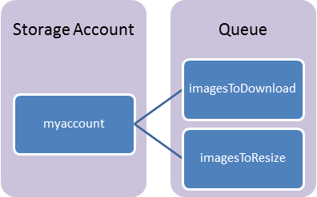
Queue Components
Storage Account: All access to Azure Storage is done through a storage account.
Queue: A queue contains a set of messages.
Message: A message, in any format, of up to 64KB.

Slide 53
Queue URL format
Queues are addressable using the following URL format:
http://{storage-account}.queue.core.windows.net/{queue}

Slide 54
Queue URL format
Example:
http://myaccount.queue.core.windows.net/imagesToDownload

Slide 55
Demo: Faster Web Applications with queues using asynchronous workloads
Notes:
Use a queue to make a web form submission faster.
Here is a list of available Azure Storage Explorers:
http://blogs.msdn.com/b/windowsazurestorage/archive/2014/03/11/windows-azure-storage-explorers-2014.aspx

Slide 56
Queue-based Load Levelling Pattern
Producers
Consumers
P₁
C₁
Queue
4
3
2
1
P₂
C₂

Slide 57
Queue Considerations
Messages are ordered but not guaranteed FIFO.
Message will be processed at least once.
Message may be processed more than once.
.DequeueCount increases every time.
-> Processing must be idempotent.

Slide 58
Queue Considerations
Messages are stored up to 7 days

Slide 59
Queue-based Load Levelling Pattern
Producers
Consumers
P₁
C₁
Queue
4
3
2
1
P₂
C₂

Slide 60
Microsoft Azure SQL Database

Slide 61
Microsoft Azure SQL Database
Notes:
SQL Database extras!

Slide 62
SQL Database Service
A relational database-as-a-service, fully managed by Microsoft.
For cloud-designed apps when near-zero administration and enterprise-grade capabilities are key.
Perfect for cloud architects and developers looking for programmatic DBA-like functionality.
Elastic scale & performance
Business
continuity & data protection
Familiar & self-managed
Predictable performance levels
Programmatic scale-out
Dashboard views of DB metrics
Self-service restore
Disaster recovery
Compliance-enabled
Familiar tools
Programmatic
Self-managed

Slide 63
Introducing new service tiers
Basic
Standard
Premium (in preview)
Light transactional workloads
The go-to option for modern business apps
Mission-critical databases
Elastic scale & performance: Six performance levels across three tiers for scale up and down based on throughput needs. Better resource isolation Improved billing experience.
Business continuity: A spectrum of business continuity features from light-weight to mission-critical across the tiers. Customers can dial up the control over data recovery and failover.
Familiar & Self-managed: Unprecedented efficiencies as your applications scale with a near-zero maintenance service and a variety of familiar management tools & programmatic APIs.

Slide 64
Designed for predictable performance
Redefined
Across Basic, Standard, and Premium, each performance level is assigned a defined level of throughput
Measure of power
Introducing the Database Throughput Unit (DTU) which represents database power and replaces hardware specs
% CPU
DTU is defined by the bounding box for the resources required by a database workload and measures power across the six performance levels.
% read
% write
Basic — 5 DTU
S0 — 10 DTU
S1 — 20 DTU
S2 — 50 DTU
P1 — 100 DTU
P2 — 200 DTU
P3 — 800 DTU
% memory

Slide 65
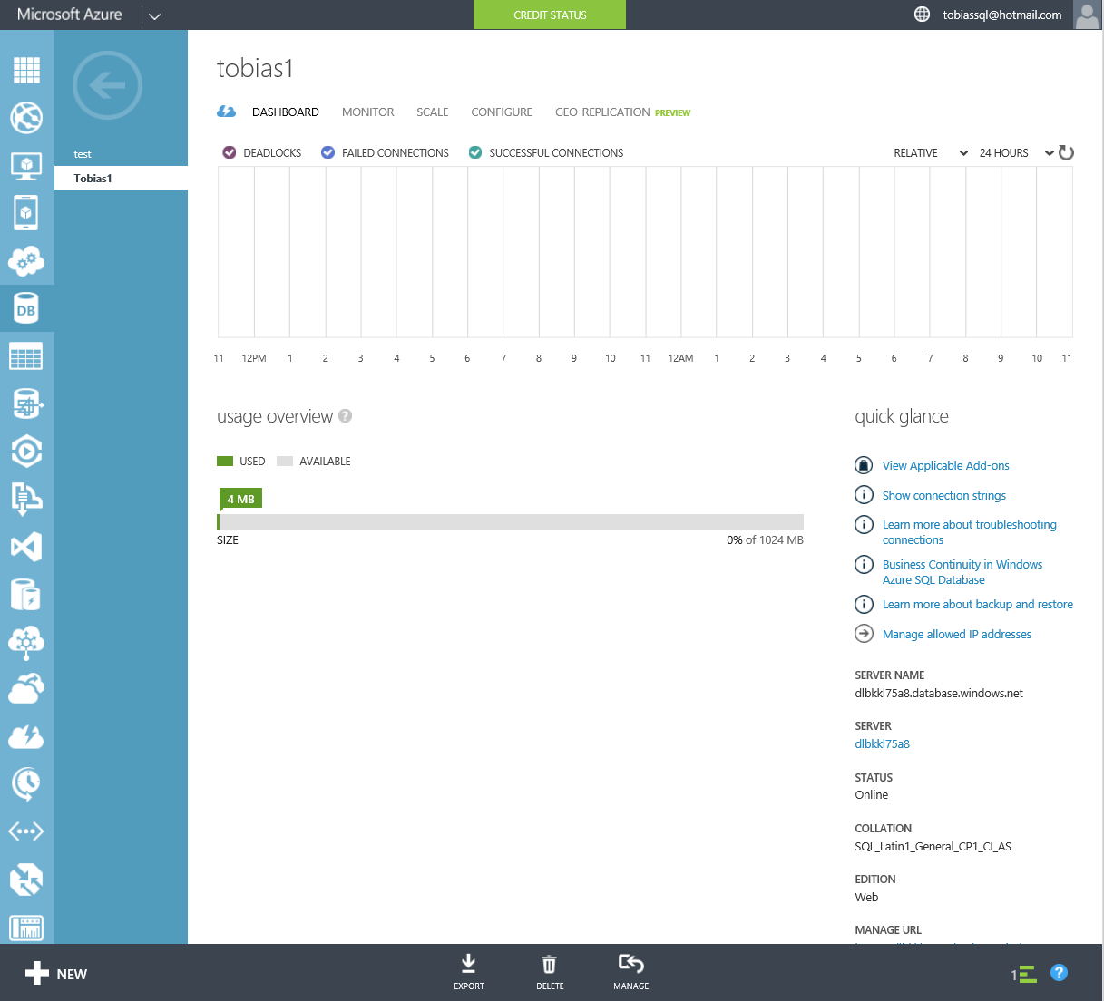
Dashboard views of metrics
Monitor
Quickly understand DB resource usage via percent of resources consumed for each resource type over time and database size
Available in the management portal & via APIs
In contrast to a VM, no system-related overhead—focused on just the resources used to run your database workload
In-depth views (DMVs) are also available for deeper understanding and trouble-shooting (for example, at the query level)

Slide 66
Self-managed
Built-in Maintenance
Remove virtually all infrastructure maintenance with SQL Database which provides automatic software patching as part of the service.
Fault tolerance
Built-in system replicas help deliver inherent data protection and database uptime. System replicas are automatically moved to new machines as old machines fail.

Slide 67
Programmatic
Dev Ops
Scale out or manage DBA-like functionality via programmatic APIs to support ongoing needs—REST & PowerShell
Platforms
Develop with a choice of popular platforms and technologies, including .NET, Java, PHP, Ruby on Rails, and Node.js.

Slide 68



Familiar
Tools
Choice of management tools; APIs, Azure Management Portal with HTML5 support, or SQL Server Management Studio.
Skills
Leverage SQL Server skills across on-premises and cloud environments with a familiar relational foundation and T-SQL functions, including spatial data support for location-based apps.
Flexible dev
Support seamless development on or offline and across on-premises and cloud-designed apps with Visual Studio. Extend existing applications to the cloud with DAC framework support.

Slide 69
SQL Database – investments this year
SLA
Increased from 99.9% to 99.99% uptime SLA
Performance
New service design point enables scale up of resources, delivering predictable throughput & performance
Protection
Point-in-time-restore, geo-restore, and standard and active geo-replication protect against human & environmental-initiated events
Compliance
Azure certifications: ISO, HIPAA BAA, EU Model Clause
Auditing on SQL Database
Flexibility
Increased max size from 150 GB to 500 GB
Moved from daily to hourly billing

Slide 70
Yes, but can it support terabytes of data?
With SQL Database scale out technology, hard limits are mitigated
SQL Database
scale up limits
DTU (throughput) currently up to 800 DTU or ~735 tx/second*
Max DB size (up to 500GB)
Customer dimensions to consider
Pure max data size
Active portion of total data
Amount of transactional workload the app will generate
Largest amount of data that needs to live in the same transactional space (i.e. database)
Scale out options
100 S2 for 5000 DTUs (max db size 25TB) ($90,000/12 months)
25 P2 for 5000 DTUs (max db size 12.5TB) ($279,000/12 months)
* Based on Azure SQL Database Benchmark estimation and specific OLTP workload configuration

Slide 71
Focus on logical vs. physical administration
Database and log files automatically placed
Three high-availability replicas maintained for every database
Tables require a clustered index
Maximum database size is 500 GB
Azure SQL Database vs. SQL Server
Notes:
Slide Objectives:
Point out that 1) The same great technologies that developers use today on-premises works with SQL Database 2) high-level differences between on-premises and SQL Database 3) SQL Database features currently unsupported
Transition:
Creating, managing, and deploying a database in Microsoft Azure SQL Database isn’t difficult. The key is understanding the features that are supported and how SQL Database compares to on-premises SQL Server and the technologies that can be used with SQL Database.
Speaking Points:
The same great technologies that developers use today on-premises works with SQL Database, including developer languages, Frameworks, and Tools. Nothing new to learn!
SQL Server Comparison -> highlight the physical vs. logical administration. Developers and DBAs can now focus on things they love to do and not worry about the physical aspect.
Features unsupported by SQL Database -> Many of the unsupported features are hardware based and thus don’t need to be in SQL Database. Other features, such as encryption, are server-based and become a challenge in solving in a shared-environment.
Notes:
CLR data types ARE supported, SQLCLR is not yet supported.
Backup/Restore: PIT Coming; Import/Export can be used for backup to BLOB storage. Third-party backup products available via RedGate and Enzo.
Data can be stored encrypted but the encryption must be done at the application level.
Native encryption is being looked at.
**Linked Servers and Distributed Queries are now supported, linking a SQL Database instance from an on-premises server. Linking two SQL Database instances is NOT supported.

Slide 72
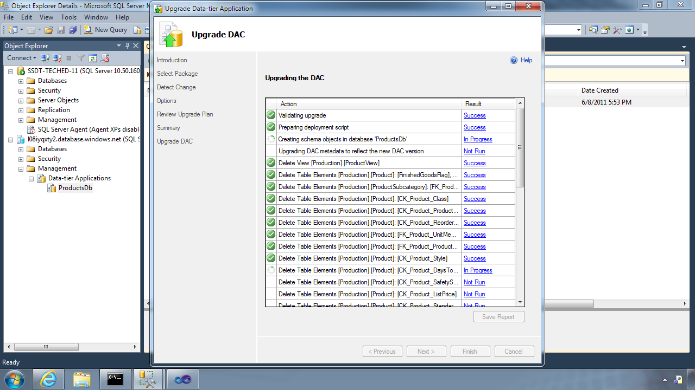
Database Deployment - Data-Tier Application Framework (DAC Fx)
Alternative to traditional script based approach
Dramatically simplifies deployment, migration and versioning of databases
Provides a single unit of deployment for schema (dacpac) or for schema + data (bacpac)
Supports automatic versioning of database schemas
Supports platform targeting for both SQL Server (2005 and above) and SQL Database
Build from scratch or extract from existing db
Notes:
Slide Objectives:
Discuss the deployment options for migrating your on-premises database to SQL Database.
Transition:
There are many ways to migrate your on-premises SQL Server database to Microsoft Azure SQL Database, but there have been great enhancements and improvements in both DAC and SSDT to dramatically improve and simplify deployment and migration options.
Speaking Points:
DAC Framework – A new unit of deployment called a bacpac which contains both schema AND data.
SQL Server Data Tools – Easily determine “Azure read” status. Provide single Publish capability.
Notes:
Both DAC and SSDT provide instant feedback as to the “azure-ready” status of your on-premises database. SSDT provides a single publish from source to destination, but DAC creates a deployment unit which can be stored in Azure storage or on-premises and used to create multiple SQL Database instances.

Slide 73
Database Deployment - How To Get The Latest DAC Fx
SQL Server Data Tools
SQL Server 2012/2014 Management Studio
SQL Database Import/Export Service
http://sqldacexamples.codeplex.com
Notes:
Slide Objectives:
Discuss the deployment options for migrating your on-premises database to SQL Database.
Transition:
There are many ways to migrate your on-premises SQL Server database to Microsoft Azure SQL Database, but there have been great enhancements and improvements in both DAC and SSDT to dramatically improve and simplify deployment and migration options.
Speaking Points:
DAC Framework – A new unit of deployment called a bacpac which contains both schema AND data.
SQL Server Data Tools – Easily determine “Azure read” status. Provide single Publish capability.
Notes:
Both DAC and SSDT provide instant feedback as to the “azure-ready” status of your on-premises database. SSDT provides a single publish from source to destination, but DAC creates a deployment unit which can be stored in Azure storage or on-premises and used to create multiple SQL Database instances.

Slide 74
loginmanager role: Server-Level security role for creating logins
dbmanager role: Server-Level security role for creating databases
SQL Database Server Security
Notes:
Slide Objectives:
Highlight the important server security aspects and benefits of SQL Database security.
Transition:
From the server perspective, there are several things that should be things that should be considered when managing the security of your SQL Database.
Speaking Points:
No Integrated Authentication
Use Master to create and drop databases
The Admin login (which was created during server provisioning) is equivalent to sa. It has full rights on the server (and all databases) and should only be used for administration.
The loginmanager role is used for creating logins: membership in this role grants CREATE / ALTER / DROP Login privileges
The dbmanager role is used for creating databases: membership in this role grants CREATE / ALTER / DROP Database privileges
Manage logins with CREATE / ALTER / DROP LOGIN commands
Notes:
Although the server-level principal login is not a member of the two database roles dbmanager and loginmanager in the master database, it has all permissions granted to these two roles.

Slide 75
Manage users with CREATE / ALTER / DROP USER commands
Add users to roles via sp_add_rolemember to grant privileges
Utilize schemas where appropriate
SQL Database Security
Notes:
Slide Objectives:
Highlight the important server security aspects and benefits of SQL Database security.
Transition:
From the server perspective, there are several things that should be things that should be considered when managing the security of your SQL Database.
Speaking Points:
No Integrated Authentication
Use Master to create and drop databases
The Admin login (which was created during server provisioning) is equivalent to sa. It has full rights on the server (and all databases) and should only be used for administration.
The loginmanager role is used for creating logins: membership in this role grants CREATE / ALTER / DROP Login privileges
The dbmanager role is used for creating databases: membership in this role grants CREATE / ALTER / DROP Database privileges
Manage logins with CREATE / ALTER / DROP LOGIN commands
Notes:
Although the server-level principal login is not a member of the two database roles dbmanager and loginmanager in the master database, it has all permissions granted to these two roles.

Slide 76
Connecting To SQL Database
Tabular Data Stream (TDS) protocol over TCP/IP
SSL required
<connectionStrings>
<addname="AdventureWorks"connectionString=
"Data Source=[server].database.windows.net;
Integrated Security=False;
Initial Catalog=ProductsDb;
User Id=[login]@[server];
Password=[password];
Trusted_Connection=False;
Encrypt=true;"
providerName="System.Data.SqlClient"/>
</connectionStrings>
Notes:
Slide Objectives:
Highlight application connectivity requirement, considerations and best practices to SQL Database.
Transition:
While connecting to SQL Database is fairly straight forward, there are some general considerations and recommended coding practices when developing Microsoft Azure SQL Database applications.
Speaking Points:
Login:
Idle connections terminated after 30 minutes
Long running transactions terminated after 24 hours
DoS guard terminates suspect connections with no error message
Failover events terminate connections
Throttling may generate errors…which leads to:
Implement Connection Pooling and Retry logic to handle transient failures
Latency introduced for updates due to HA replicas
No cross-database dependencies: resultsets from different database must be combined in the application tier (Fan out queries)
Notes:

Slide 77
There are two ways to Secure a database
On The Server
Within The Database
Notes:
Slide Objectives:
Highlight the two areas where Microsoft Azure SQL Database can be secured.
Transition:
Security is vitally important and has not be overlooked. Microsoft Azure SQL Database takes security seriously.
Speaking Points:
Set security options on the server itself
Security within the database
Notes:
This doesn’t leave the application free of any responsibility…some settings are required to be set within the application.

Slide 78
SQL authentication supported
No Integrated authentication
The Admin login is similar to sa
Connect to master to administer logins
On The Server
Notes:
Slide Objectives:
Highlight the important server security aspects and benefits of SQL Database security.
Transition:
From the server perspective, there are several things that should be things that should be considered when managing the security of your SQL Database.
Speaking Points:
No Integrated Authentication
Use Master to create and drop databases
The Admin login (which was created during server provisioning) is equivalent to sa. It has full rights on the server (and all databases) and should only be used for administration.
The loginmanager role is used for creating logins: membership in this role grants CREATE / ALTER / DROP Login privileges
The dbmanager role is used for creating databases: membership in this role grants CREATE / ALTER / DROP Database privileges
Manage logins with CREATE / ALTER / DROP LOGIN commands
Notes:
Although the server-level principal login is not a member of the two database roles dbmanager and loginmanager in the master database, it has all permissions granted to these two roles.

Slide 79
Logins require an associated user account
Admin login is automatically associated with dbo
The dbo has full rights in the database
Within The Database
Notes:
Slide Objectives:
Highlight the important server security aspects and benefits of SQL Database security.
Transition:
From the server perspective, there are several things that should be things that should be considered when managing the security of your SQL Database.
Speaking Points:
No Integrated Authentication
Use Master to create and drop databases
The Admin login (which was created during server provisioning) is equivalent to sa. It has full rights on the server (and all databases) and should only be used for administration.
The loginmanager role is used for creating logins: membership in this role grants CREATE / ALTER / DROP Login privileges
The dbmanager role is used for creating databases: membership in this role grants CREATE / ALTER / DROP Database privileges
Manage logins with CREATE / ALTER / DROP LOGIN commands
Notes:
Although the server-level principal login is not a member of the two database roles dbmanager and loginmanager in the master database, it has all permissions granted to these two roles.

Slide 80
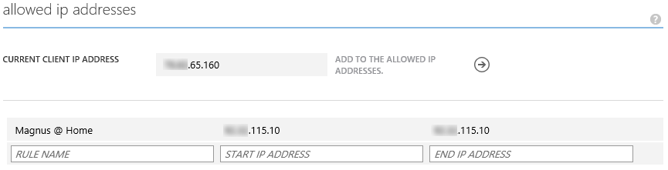
SQL Database Security with the Firewall
IP Address-based access control for SQL Database
Rules can be defined at the server and database
No IP authorized by default
Configurable using the SQL Database Portal and REST API
Option to disable/enable access from applications hosted in Microsoft Azure
Notes:
Slide Objectives:
Illustrate the how SQL Database Firewall
Transition:
Transition statement(s) to setup the slide
Speaking Points:
By default, no-one is allowed to access the database.
Server Rules enable clients to access your entire SQL Database server
Database rules enable clients to access individual databases within your SQL Database server
Rules are originating IP Address-based.
Notes:
Maximum of 128 Rules
Rather than using a REST API like the other Azure storage services, SQL Database is accessed via Tabular Data Stream (TDS), the same protocol used by Microsoft SQL Server (operating over port TCP/1433). To help protect the data, the SQL Database firewall prevents all access to your SQL Database server until you specify which computers have permission.
Initially, all access to your SQL Database server is blocked by the SQL Database firewall; connection attempts originating from the Internet or Microsoft Azure will not be able to reach your SQL Database server. In order to begin using your SQL Database server, you must go to the SQL Database Portal and specify one or more firewall settings that enable access to your SQL Database server. Use the firewall settings to specify which IP address ranges from the Internet are allowed, and whether or not Microsoft Azure applications can attempt to connect to your SQL Database server.

Slide 81
Connecting To SQL Database
The same way you’ve always done it!
<connectionStrings>
<add name="AdventureWorks"connectionString=
"Data Source= [server].database.windows.net;
Integrated Security=False;
Initial Catalog=ProductsDb;
User Id=[login]@[server];
Password=[password];
Trusted_Connection=False;
Encrypt=true;"
providerName="System.Data.SqlClient"/>
</connectionStrings>
Notes:
Slide Objectives:
Highlight application connectivity requirement, considerations and best practices to SQL Database.
Transition:
While connecting to SQL Database is fairly straight forward, there are some general considerations and recommended coding practices when developing Microsoft Azure SQL Database applications.
Speaking Points:
Login:
Idle connections terminated after 30 minutes
Long running transactions terminated after 24 hours
DoS guard terminates suspect connections with no error message
Failover events terminate connections
Throttling may generate errors…which leads to:
Implement Connection Pooling and Retry logic to handle transient failures
Latency introduced for updates due to HA replicas
No cross-database dependencies: resultsets from different database must be combined in the application tier (Fan out queries)
Notes:

Slide 82
SQL Database Considerations and Best Practices
login: [login]@[server]
Idle connections
Long running transactions
Notes:
Slide Objectives:
Highlight application connectivity requirement, considerations and best practices to SQL Database.
Transition:
While connecting to SQL Database is fairly straight forward, there are some general considerations and recommended coding practices when developing Microsoft Azure SQL Database applications.
Speaking Points:
Login:
Idle connections terminated after 30 minutes
Long running transactions terminated after 24 hours
Notes:

Slide 83
SQL Database Considerations and Best Practices
DoS guard
Failover events
Throttling
Notes:
Slide Objectives:
Highlight application connectivity requirement, considerations and best practices to SQL Database.
Transition:
While connecting to SQL Database is fairly straight forward, there are some general considerations and recommended coding practices when developing Microsoft Azure SQL Database applications.
Speaking Points:
DoS guard terminates suspect connections with no error message
Failover events terminate connections
Throttling may generate errors…which leads to:
Implement Connection Pooling and Retry logic to handle transient failures
Latency introduced for updates due to HA replicas
No cross-database dependencies: resultsets from different database must be combined in the application tier (Fan out queries)
Notes:

Slide 84
SQL Database Considerations and Best Practices
Connection pooling and Retry logic
Latency introduced for updates
No cross-database dependencies
Notes:
Slide Objectives:
Highlight application connectivity requirement, considerations and best practices to SQL Database.
Transition:
While connecting to SQL Database is fairly straight forward, there are some general considerations and recommended coding practices when developing Microsoft Azure SQL Database applications.
Speaking Points:
Login:
Idle connections terminated after 30 minutes
Long running transactions terminated after 24 hours
DoS guard terminates suspect connections with no error message
Failover events terminate connections
Throttling may generate errors…which leads to:
Implement Connection Pooling and Retry logic to handle transient failures
Latency introduced for updates due to HA replicas
No cross-database dependencies: resultsets from different database must be combined in the application tier (Fan out queries)
Notes:

Slide 85
Elastic Scale
Notes:
Extra Elastic Scale slides!

Slide 86
When is Elastic Scale the right consideration?
Application workload can be partitioned across a number of scale units, and workload directed to each partition can fit into the biggest scale unit available
Application workload doesn’t contain large scans or aggregations that need to touch the entire data set
Total capacity demands (CPU, IO, memory, storage) of the application exceed the hard limits of a single Azure SQL Database scale unit
Application requires on-demand or automatic policy-driven scale out or scale in
Caveat: Typical data warehousing does not easily fit the patterns for Elastic Scale

Slide 87
Scalability = Capacity * Density
Adding more Capacity
Using Capacity more Efficiently
Identifying and breaking contention and choke points
How to add additional capacity to a solution?
There are subtle constraints to consider...
Traditional performance tuning
Maximize application throughput (e.g leveraging batching)
Improving network performance

Slide 88
Common database scalability patterns
Single large database
Fabrikam
Inventory
Order
Vertically partitioned
Invoice
1 tenant: 1 DB (ISV/CSV)
Root
Cust. #2
Cust. #n
Cust. #1
Other partitioning scheme
Root
Shard #1
Shard #2
Shard #n

Slide 89
How to peel apart customer requirements
Customer example: 9 TB data | 5000 tx*/sec | 100GB largest shard
SQL Database
scale up limits
DTU (throughput) currently up to 800 DTU or ~735 tx/second*
Max DB size (up to 500GB)
Customer dimensions to consider
Pure max data size
Active portion of total data
Amount of transactional workload the app will generate
Largest amount of data that needs to live in the same transactional space (i.e. database)
Scale out options
100 S2 for 5000 DTUs (max db size 25TB) ($90,000/12 months)
25 P2 for 5000 DTUs (max db size 12.5TB) ($279,000/12 months)**
* Based on Azure SQL Database Benchmark estimation
** Will provide additional Business Continuity features

Slide 90
Multi-Tenant SaaS
Central directory where customer profiles are stored
One database per end customer (tenant)
Often for security and isolation
Some rely on schema customization
Data dependent routing is common data access path
Highly selective key lookup queries, multi-joins, etc.
Mid to low data entry rate
No need for cross-customers (fan-out) queries
Most tenants are small and “cold”, some may have hot spots
Optimizing COGS by picking the right Service Tier for the customer (mostly Basic)
Example
MYOB
Sage

Slide 91
Continuous data collection
Sensor and Telemetry Processing
Large data ingestion workloads
Mostly append only (Cola bottling analogy)
Two options, depending on application query patterns
Querying ranges of last X days of data (e.g. trend analysis)
Randomly extracting data from the entire database (e.g. lookup a certain Jan event)
Typically requires fan-out queries
App
App
reads
reads
reads
writes
reads/writes
reads/writes
reads
reads/writes
reads/writes
Jan
Feb
Mar
Oct
Nov
#1
#2
#3
…..
#N
…
…
Time
Scale

Slide 92
High Scale OLTP
Large, (mostly) uniform, active data set
Distribute partition-able tables across as many shards as necessary
See Appendix for shards (scale units) capacity planning
Some shards can become way more active than others
Pinning hot users to dedicated databases
Move users to balance workload between databases
Scale to the proper Service Tier (Premium) to deal with increased workload
Split-merge actions are required to fully exploit elasticity
Mostly data dependent routing with key lookup queries
Few fan-out queries may be required (e.g. leaderboards, inventory management, etc.)
Examples
Pottermore

Slide 93
Sharding and Tenancy Models
Single tenant per database
Each tenant’s data is stored in a different database
Better isolation of tenants as compared to multi-tenant model
Multiple tenants per database
Multiple tenants share the same database
Less isolation of tenants as compared to single tenant model
Typically more cost-effective than the single tenant model
Hybrid model
Some tenants share databases, others get their own database
E.g., premium or paying customers get their own databases, while free tier customers share databases
Temporal model
Sharding based on date/time
Most recent shard is constantly loaded with newly arriving data
New shards added when current most recent shard nears capacity

Slide 94



Elastic Scale: Overview
Elastic Scale app
Cross-Shard Capabilities
Elastic Scale
Manage-ability
Client library
Cross-shard extensions
Cross-shard
operations
Cross-shard
operations
Application
Developer
Admin/
DevOps
shard₁
shard_{i}
shard_{j}
shard_{n}
Client library
Shard-local
operations
Shard-local
operations
…
…
…
Grow/shrink capacity
Admin/
DevOps

Slide 95
Elastic Scale: Key Capabilities
Client .NET APIs
Management Services
Shard map management (SMM)
Define groups of shards for your application
Manage mapping of routing keys to shards
Data dependent routing (DDR)
Route incoming requests to the correct shard, e.g., given a customer ID
Ensure correct routing as tenants move
Cache routing information for efficiency
Multi-shard query (MSQ)
Interactive processing across several shards
Same statement executed on all shards with UNION all semantics
Shard Set Execution (SSE)
Interactive processing across several shards
Same statement executed on all shards with UNION all semantics
Split/Merge (SM)
Grow or shrink capacity by adding or removing scale units
Dynamically adjust scale factor of scale unit
Trigger adjustment dynamically through policies
Shard Elasticity (SE)
Dynamically adjust scale factor of scale unit
Trigger adjustment dynamically through policies

Slide 96
Elastic Scale Overview
Two types of shard maps
Range: contiguous values
List: explicit values
Four types of sharding keys
INT, BIGINT, GUID, VARBINARY
[shardmaps_global]
smid | name
1 | RangeShardMap
[shards_global]
sid | smid | Datasource | Databasename
1 | 1 | serverName | DB2
2 | 1 | serverName | DB2
[shard_mappings_global]
mid | smid | min | max | Sid
1 | 1 | 0 | 100 | 1
2 | 1 | 100 | 200 | 2
Shard Map Manager
DB₁
_{[0-100)}
DB₂
_{[100-200)}
DB₃
_{[200-300)}
DB₄
_{[300-400)}
DB₅
_{[400-500)}
DB₅
_{[500-600)}
DB_{n}
_{[n-n+100)}
. . .
Shard Set

Slide 97


Elastic Scale Overview
Two classes of operations:
Individual shards
Cross shards
Two Personas:
Application Developer
Admin/DevOps
.NET Client Api
Customer Hosted Services
Application
Developer
Admin/
DevOps
Query a specific shard
Query multiple shards
Capacity, cost mgmt.
DB Maintenance, DDL
DB₁
_{[0-100)}
DB₂
_{[100-200)}
DB₃
_{[200-300)}
DB₄
_{[300-400)}
DB₅
_{[400-500)}
DB₅
_{[500-600)}
DB_{n}
_{[n-n+100)}
. . .

Slide 98
Data Dependent Routing (DDR)
Scenario: query a shard with a specific shardlet key
Shard Map Manager
Client App
DDR APIs ( )
Application
Developer
Admin/
DevOps
SELECT *
FROM customers
WHERE customer ID = 104
DB₁
_{[0-100)}
DB₂
_{[100-200)}
DB₃
_{[200-300)}
DB₄
_{[300-400)}
DB₅
_{[400-500)}
DB₅
_{[500-600)}
DB_{n}
_{[n-n+100)}
. . .

Slide 99
Data Dependent Routing (DDR)
// Get a routed connection for a given shardingKey
using (SqlConnection conn = ShardMap.OpenConnectionForKey(
shardingKey,
connectionString /* Credentials Only */ ,
ConnectionOptions.Validate /* Validate */ ));
{
using (SqlCommand cmd = new SqlCommand()
{
cmd.Connection = conn;
cmd.CommandText = "SELECT dbNameField, TestIntField, TestBigIntField FROM ShardedTable";
SqlDataReader sdr = cmd.ExecuteReader();
// Now consume results from the data reader…
}
}

Slide 100
Data Dependent Routing (DDR)
Caching: improve performance of shard operations
Global Shard Map (GSM) – state of all shards in the Shard Map
Local Shard Map (LSM) – state of all shards on a particular shard
Client Cache (eager/lazy) – state of all shards in the Shard Map/known shards
Shard Map Manager
Client App
DDR APIs ( )
Application
Developer
GSM
Cache
DB₁
_{[0-100)}
LSM

Slide 101
Multi-shard Query (MSQ)
Scenario: execute a query across a set of shards (returns a UNION ALL result set)
Shard Map Manager
Client App
MSQ APIs ( )
Application
Developer
Admin/
DevOps
SELECT count(*)
FROM customers
UNION ALL result set
DB₁
_{[0-100)}
DB₂
_{[100-200)}
DB₃
_{[200-300)}
DB₄
_{[300-400)}
DB₅
_{[400-500)}
DB₅
_{[500-600)}
DB_{n}
_{[n-n+100)}
. . .

Slide 102
Multi-shard Query (MSQ)
using (MultiShardConnection conn = new MultiShardConnection(m_shardMap.GetAllShards(null), MultiShardTestUtils.GetTestSqlCredential()))
{
using (MultiShardCommand cmd = conn.CreateCommand())
{
cmd.CommandText = "SELECT dbNameField, TestIntField, TestBigIntField FROM ShardedTable";
cmd.CommandType = CommandType.Text;
cmd.Policy = MultiShardPolicy.PartialResults;
using (MultiShardDataReader sdr = cmd.ExecuteReader(includeShardNameColumn: true))
{
while (sdr.Read())
{
var dbNameField = sdr.GetString(0);
var testIntField = sdr.GetFieldValue<int>(1);
var testBigIntField = sdr.GetFieldValue<Int64>(2);
string shardIdPseudoColumn = sdr.GetFieldValue<string>(3);
}
}
}
}

Slide 103
Shard Set Executer (SSE)
Scenario: perform an admin action across of set of shards
Customer Hosted Services
(SSE)
Application
Developer
Admin/
DevOps
CREATE TABLE foo (col1 INT)
DB₁
_{[0-100)}
DB₂
_{[100-200)}
DB₃
_{[200-300)}
DB₄
_{[300-400)}
DB₅
_{[400-500)}
DB₅
_{[500-600)}
DB_{n}
_{[n-n+100)}
. . .

Slide 104
Split/Merge (SM)
Scenario: perform a split or merge action
Split: create two distinct shards from one
Merge: create one shard from two distinct shards
Customer Hosted Services
(SM)
Application
Developer
Admin/
DevOps
Merge
Split
DB₁
_{[0-100)}
DB₂
_{[100-200)}
DB₃
_{[200-300)}
DB₄
_{[300-400)}
DB₅
_{[400-500)}
DB₅
_{[500-600)}
DB_{n}
_{[n-n+100)}
. . .
DB_{2.1}
_{[100-300)}
DB_{5.1}
_{[400-450)}
DB_{5.2}
_{[450-500)}

Slide 105
Shard Elasticity (SE)
Scenario: automation to vertically scale a shard or horizontally scale a shardset
Vertical scale: increase/decrease the performance level of the shard
Horizontal scale: add/remove a shard to the shard set
Azure Automation (SE)
Application
Developer
Admin/
DevOps
Vertical scaling
DB₅
_{[500-600)}
DB₅
_{[400-500)}
DB₄
_{[300-400)}
Horizontal scaling
DB₁
_{[0-100)}
DB₂
_{[100-200)}
DB₃
_{[200-300)}
DB_{n}
_{[n-n+100)}
. . .
Basic
Basic
Basic
S2
P1
P3
time

Slide 106
References
Client library and service packages are available on Nuget.org
Search for ‘Elastic Scale’ to find the projects on Nuget.org
Search for ‘Elastic Scale’ in the VS Package Manager to find the DLL
Client library: http://www.nuget.org/packages/Microsoft.Azure.SqlDatabase.ElasticScale.Client/
Split/Merge: http://www.nuget.org/packages/Microsoft.Azure.SqlDatabase.ElasticScale.Service.SplitMerge/
Documentation on Azure.com in the SQL Database section
Search for ‘elastic scale documentation map azure.com’
Get stared: http://azure.microsoft.com/en-us/documentation/articles/sql-database-elastic-scale-get-started/
Documentation map: http://azure.microsoft.com/en-us/documentation/articles/sql-database-elastic-scale-documentation-map/
Samples in the VS code samples gallery
Search for ‘Elastic Scale’ on https://code.msdn.microsoft.com/
Search for ‘Elastic Scale’ in the Online Samples section for new VS projects

Slide 107

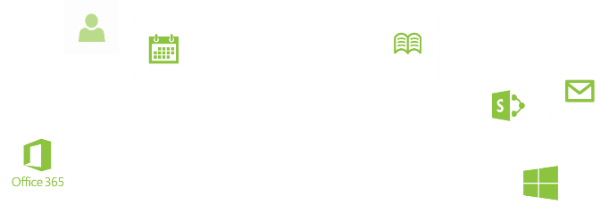
Elastic Scale Recap
Support key large scenarios at scale in Azure SQL Database
High-volume OLTP
Continuous data collection
Multi-tenant SaaS
Elastic Scale offers built-in technology
Transparency at the app tier through Elastic Scale APIs
Azure cloud service templates to manage Elastic Scale app at runtime
Key workloads can now scale freely in Azure SQL Database
Elastic resources and capacity
No longer limited to a single database or its hard limits
Match aggregate capacity of all shard to overall capacity
needs of the app

Slide 108
A Server is not a machine
SQL Server
Machine
(Physical/VM)
Azure
SQL Database Server
TDS Endpoint
Notes:
Slide Objectives:
Understand that while there are physical SQL Server boxes behind the scenes, when connecting to SQL Database, you are not connecting to a physical server, but to a TDS endpoint.
Transition:
The key to understanding SQL Database is understanding while SQL Database is SQL Server, we do not interact with them in the same physical manner.
Speaking Points:
In an on-premises environment, we typically have physical access to the actual SQL Server server.
In Microsoft Azure, we do not have physical access to the actual server.
Notes:
It is important that the attendee understands that it IS INDEED SQL Server at the platform layer. There are physical boxes running SQL Server 2012 Enterprise Edition. However, due to the nature of the Azure environment to provide the high-availability and scalability necessary, access to the physical boxes is currently not supported.

Slide 109
Scale out with ElasticScale
Built-in regional database replicas for additional protection
Uptime SLA of 99.99%
SQL Database – The Basics
Notes:
Slide Objectives:
Understand the overall concepts and benefits of SQL Database
Transition:
Let’s clear up any confusion and look at the basics of what SQL Database really is and some of its benefits.
Speaking Points:
The same great SQL Server database technology that you know, love, and use on-premises provided as a service
Enterprise-ready
Automatic support for High-Availability
Designed to scale on-demand to provide the same great elasticity
Notes:
High-availability – 3 copies of the database free for the cost of the one database. Always in sync. The cost to do this on-premises isn’t cheap. This is FREE in SQL Database.

Slide 110
SQL Database
Notes:
Now let’s focus on Microsoft Azure SQL Database the PaaS service!

Slide 111

Microsoft Relational Storage Options
A Continuous offering
Physical
Virtual
IaaS
PaaS
From private to public Cloud
Notes:
Slide Objectives:
Show Microsoft’ continuous Private to Public Cloud Offering, but this presentation will focus on Microsoft’s relational database PaaS offering.
Transition:
Microsoft provides a continuous solution from private cloud to the public cloud. No matter where you are on your technology roadmap we have a solution to fit your needs.
We are a trusted advisor and platform in the traditional enterprise and ISV space with new IaaS offerings that making it easier to bring this same level of trust and ease of use to the public cloud. However, Microsoft Azure SQL Database extends SQL Server capabilities to the cloud by offering SQL Server as a relational database service.
Speaking Points:
SQL Database provides SQL Server as a relational service.

Slide 112
Architecture
Starting with the basics

Slide 113
A Server is not a machine
SQL Server
Machine
(Physical/VM)
Azure
SQL Database Server
TDS Endpoint
Notes:
Slide Objectives:
Understand that while there are physical SQL Server boxes behind the scenes, when connecting to SQL Database, you are not connecting to a physical server, but to a TDS endpoint.
Transition:
The key to understanding SQL Database is understanding while SQL Database is SQL Server, we do not interact with them in the same physical manner.
Speaking Points:
In an on-premises environment, we typically have physical access to the actual SQL Server server.
In Microsoft Azure, we do not have physical access to the actual server.
Notes:
It is important that the attendee understands that it IS INDEED SQL Server at the platform layer. There are physical boxes running SQL Server 2012 Enterprise Edition. However, due to the nature of the Azure environment to provide the high-availability and scalability necessary, access to the physical boxes is currently not supported.

Slide 114
SQL Database The Basics
SQL Server database technology “as a Service”
Fully Managed
Enterprise-ready with automatic support for HA, DR, Backups, replication and more
Notes:
Slide Objectives:
Understand the overall concepts and benefits of SQL Database
Transition:
Let’s clear up any confusion and look at the basics of what SQL Database really is and some of its benefits.
Speaking Points:
The same great SQL Server database technology that you know, love, and use on-premises provided as a service
Enterprise-ready
Automatic support for High-Availability
Designed to scale on-demand to provide the same great elasticity
Notes:
High-availability – 3 copies of the database free for the cost of the one database. Always in sync. The cost to do this on-premises isn’t cheap. This is FREE in SQL Database.

Slide 115
SQL Database The Basics
Scale out with ElasticScale
Built-in regional database replicas for additional protection
Uptime SLA of 99.99%
Notes:
Slide Objectives:
Understand the overall concepts and benefits of SQL Database
Transition:
Let’s clear up any confusion and look at the basics of what SQL Database really is and some of its benefits.
Speaking Points:
The same great SQL Server database technology that you know, love, and use on-premises provided as a service
Enterprise-ready
Automatic support for High-Availability
Designed to scale on-demand to provide the same great elasticity
Notes:
High-availability – 3 copies of the database free for the cost of the one database. Always in sync. The cost to do this on-premises isn’t cheap. This is FREE in SQL Database.

Slide 116
How It Works – Architecture of the Service
Client Layer
PHP
SQL Server
Applications
and Tools
WCF Data Services
Applications communicate directly with SQL Database using TDS.
ODBC
ADO.NET
Tabular Data Stream (TDS)
Notes:
Client - The client layer resides closest to your application, and is used by your application to communicate directly with SQL Database. The client layer can reside on-premise in your datacenter or be hosted in Microsoft Azure. Because SQL Database provides the same tabular data stream (TDS) interface as SQL Server, you can use familiar tools and libraries to build client applications for data that is in the cloud.

Slide 117
How It Works – Architecture of the Service
Client Layer
PHP
SQL Server
Applications
and Tools
WCF Data Services
ODBC
ADO.NET
Tabular Data Stream (TDS)
TDS+SSL
Gateway between Client layer and Platform layer.
Services Layer
Provisioning
Billing and Metering
Connection Routing
Notes:
Services - The services layer functions as a gateway between the client layer and the platform layer, where the data resides. The services layer provides three functions: provisioning, billing and metering, and connection routing.
The services layer provisions the databases that you specify with your Microsoft Azure platform account. The billing and metering aspect of the services layer enables multi-tenant support by providing monitoring and billing for database usage based on individual Microsoft Azure platform accounts. SQL Database is built on a scalable platform involving numerous physical servers; this layer handles all the connections routing between your application and the physical servers where your data resides.

Slide 118
How It Works – Architecture of the Service
Client Layer
PHP
SQL Server
Applications
and Tools
WCF Data Services
ODBC
ADO.NET
Tabular Data Stream (TDS)
TDS+SSL
Services Layer
Provisioning
Billing and Metering
Connection Routing
Includes physical servicers and services that support the Services layer.
Platform Layer
SQL Server
SQL Database Fabric
Management Services
Notes:
Platform - The platform layer includes the physical servers and services that support the services layer. The platform layer consists of many instances of SQL Server, each of which is managed by the SQL Database fabric.
The SQL Database fabric is a distributed computing system composed of tightly integrated networks, servers, and storage. It enables automatic failover, load balancing, and automatic replication between physical servers.
Management services monitor the health of individual servers and enable automated installation of service upgrades and software patches.

Slide 119
How It Works – Architecture of the Service
Client Layer
PHP
SQL Server
Applications
and Tools
WCF Data Services
ODBC
ADO.NET
Tabular Data Stream (TDS)
TDS+SSL
Services Layer
Provisioning
Billing and Metering
Connection Routing
Platform Layer
SQL Server
SQL Database Fabric
Administration of the physical HW and OS.
Management Services
Infrastructure Layer
Notes:
Infrastructure - The infrastructure layer represents the IT administration of the physical hardware and operating systems that support the services layer.

Slide 120
How It Works – Architecture of the Service
Client Layer
PHP
SQL Server
Applications
and Tools
WCF Data Services
ODBC
ADO.NET
Tabular Data Stream (TDS)
TDS+SSL
Services Layer
Provisioning
Billing and Metering
Microsoft Azure SQL Database
PaaS
Connection Routing
Platform Layer
SQL Server
SQL Database Fabric
Management Services
Infrastructure Layer
Notes:
Slide Objectives:
To understand the actual architecture that provides the enterprise-ready SQL Database service.
Transition:
Developers have spent years working with their technology of choice, and Microsoft wanted to ensure that the technologies and tools you use today will continue to work with SQL Database without learning a whole new set of technologies.
Speaking Points:
Familiar technology and tools
Similar architecture as that of on-premises
Additional layer providing server and database partitioning, client connection routing, and billing.
Same great SQL Server technology on the backend.
Additional services (SQL Database Fabric) to ensure SLAs are met and to ensure optimum performance.

Slide 121
SQL Database Server
The Service head contains databases
Connect via automatically generated FQDN: {name}.database.windows.net
Initially contains only a master database
Notes:
Slide Objectives:
Show the different methods of provisioning a SQL Database server along with how easy it is. Plus, help the attendees understand what a SQL Database “server” really is.
Transition:
Provisioning an on-premises SQL Server box can be time consuming, costly, and at times, a challenge. With SQL Database, provisioning a “server” is painless, quick, and provisioned in a matter of seconds.
Speaking Points:
Provision servers interactively using the Management Portal
Automate server provisioning using the Microsoft Azure Management API or PowerShell.
Notes:
While the “server” is technically a TDS endpoint, much of the SQL Server process is similar. Administration login credentials are still needed for security, and more importantly defining service access is essential, and required, for maintaining the integrity of your server through firewall rules.

Slide 122






Server Connectivity
IP Based Firewall Rules
SQL Database Server
Allow Azure Services
Full Access
Selective Access
Azure Services
Notes:
Slide Objectives:
Explain SQL Server Database Connectivity.
Speaking Points:
Explain how data is protected using server-level firewall and database-level firewall rules.
Explain the difference when services connecting to SQL Databases from the internet versus services connecting from the Azure Datacenters.

Slide 123
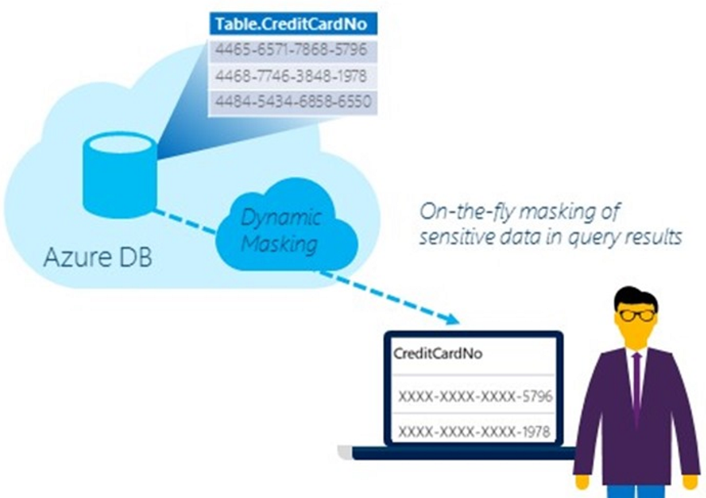
Dynamic Data Masking
Limits sensitive data exposure
Prevents unauthorized access to data
Policy-based security – no changes to data or application
Meet regulatory compliance
Dev/Test production data without compromising data
Protect Sensitive Data
Limit Exposure of Sensitive Data
Notes:
Speaker notes:
Limit sensitive data(e.g. customer or PII) exposure by masking data to non-privileged users in real time
Limit the exposure of sensitive data to meet industry compliance policies
Policy-based security feature hides the sensitive data in the result set of a query over designated database fields, while the data in the database is not changed and as a result require no changes to the Application layer.
A developer can query production environments for troubleshooting purposes without violating compliance regulations

Slide 124
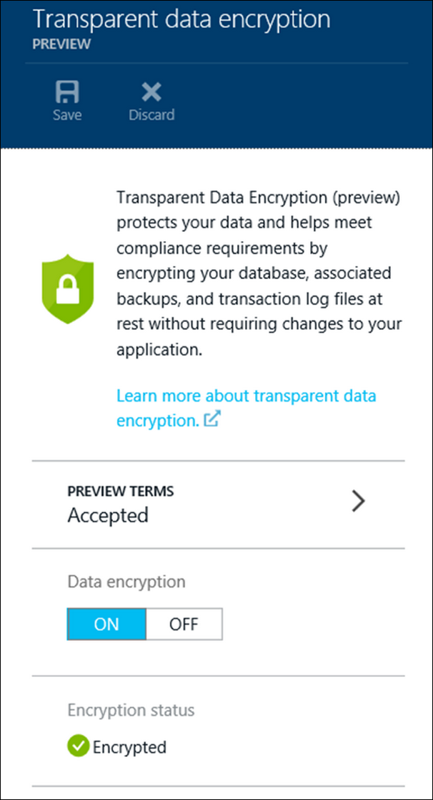
Transparent Data Encryption (TDE)
Encrypted database, backups, and transaction log at rest
2-click provisioning
Reduced attack surface area
No code changes to existing applications
Database encryption key - AES-256
Meet regulatory compliance
Accelerated hardware encryption
Encrypt and Protect Database
Notes:
Speaker notes:
Protect your data by encrypting your database, associated backups, and transaction log files at rest in real-time without requiring changes to your application
Help you meet regulatory compliance
An entire database is encrypted by using an industry standard AES-256 symmetric key by the service
Easy as a 2 clicks to provision the service and all key management for database copying, Geo-Replication, and database restores anywhere in SQL Database is handled by the service
Support for Intel AES-NI hardware acceleration of encryption. This will reduce the CPU/DTU overhead of turning on Transparent Data Encryption

Slide 125
Row-Level Security (RLS)
Fine-grained access over rows
Access restrictions logic contained in database
Simplified design and coding of security
Meet regulatory compliance
Reduced surface area of your security system
Fine-grained Access Over Rows
Notes:
Speaker notes:
Allow for data protection when multiple users or applications need to access different records in the same database tables. For example, implement restrictions on data rows to users pertinent to their department or restricting a customer's data access to only the data relevant to their company.
The access restriction logic is located in the database tier rather than away from the data in another application tier. Simplifies the design and coding of security in your application
Makes your security system more reliable and robust by reducing the surface area of your security system

Slide 126
Other notable features
Contained Database Users
Parallel Queries
Common Language Runtime (CLR) assemblies
Fine-grained Access Over Rows
Notes:
Speaker Notes:
SQL Database authenticate at the database level by using contained database users making databases more portable
Parallel Queries support heavier workloads
Author stored procedures, triggers, user-defined functions, user-defined types, and user-defined aggregates in managed code

Slide 127
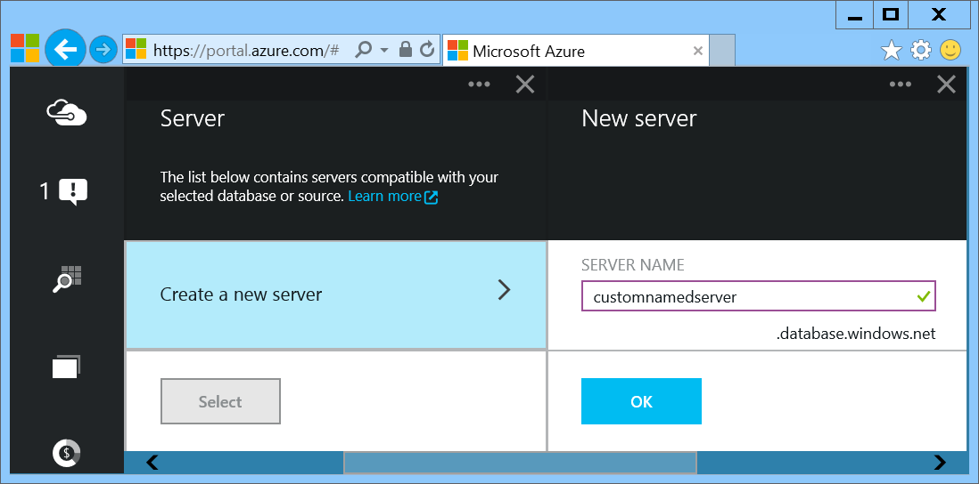
Provision Servers Interactively
In the Preview Management Portal create a SQL Database server
Notes:
Important: In the Preview Management Portal you are able to create a custom server FQDN! In the Management Portal that name is randomized.
Slide Objectives:
Show the different methods of provisioning a SQL Database server along with how easy it is. Plus, help the attendees understand what a SQL Database “server” really is.
In the Preview Portal you can select the name of the server you create!
Transition:
Provisioning an on-premises SQL Server box can be time consuming, costly, and at times, a challenge. With SQL Database, provisioning a “server” is painless, quick, and provisioned in a matter of seconds.
Speaking Points:
Provision servers interactively using the Management Portal
Automate server provisioning using the Microsoft Azure Management API or PowerShell.
Notes:
While the “server” is technically a TDS endpoint, much of the SQL Server process is similar. Administration login credentials are still needed for security, and more importantly defining service access is essential, and required, for maintaining the integrity of your server through firewall rules.

Slide 128
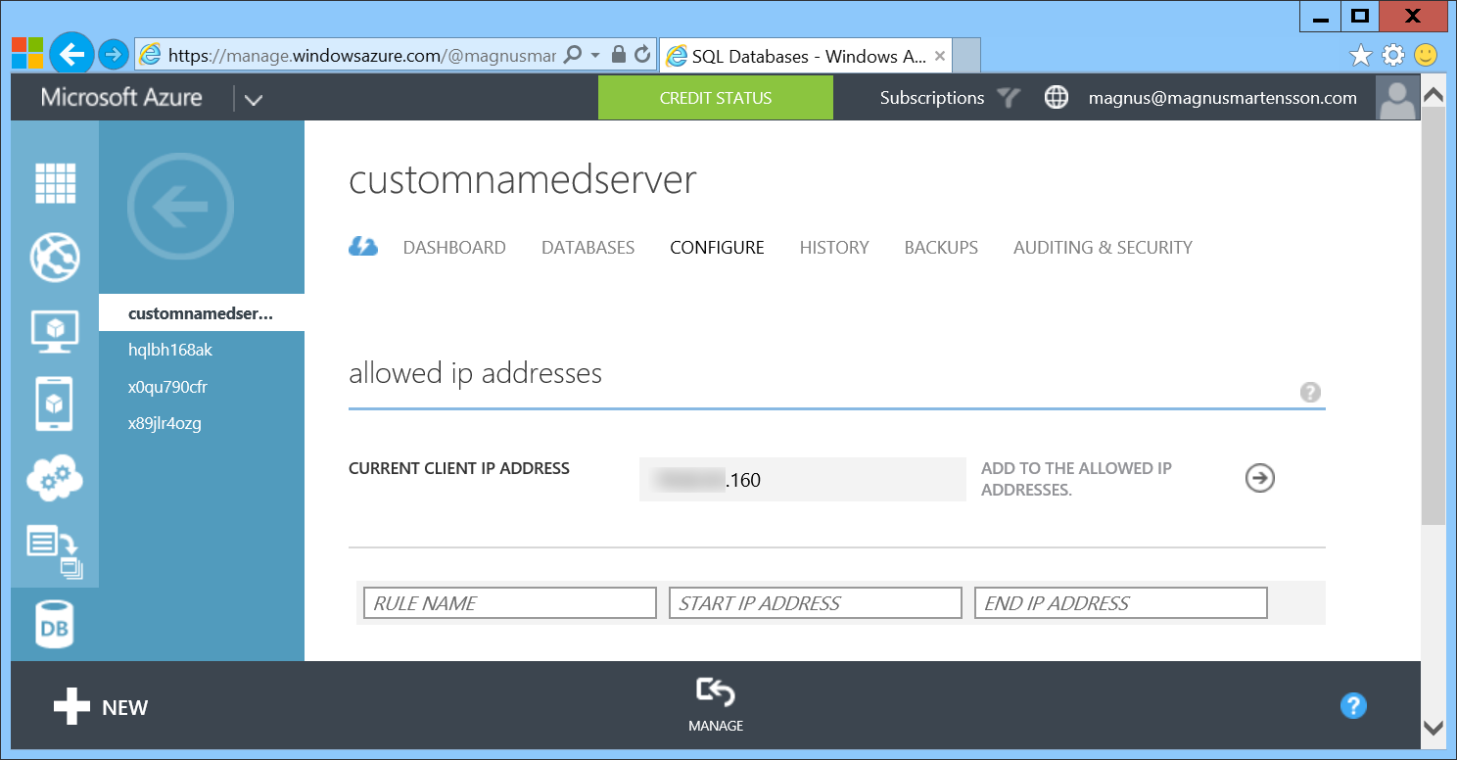
Provision Servers Interactively
In the Management Portal add firewall rules
Notes:
Slide Objectives:
Show how to configure IP-Filtering in the firewall for the SQL Database Server.

Slide 129
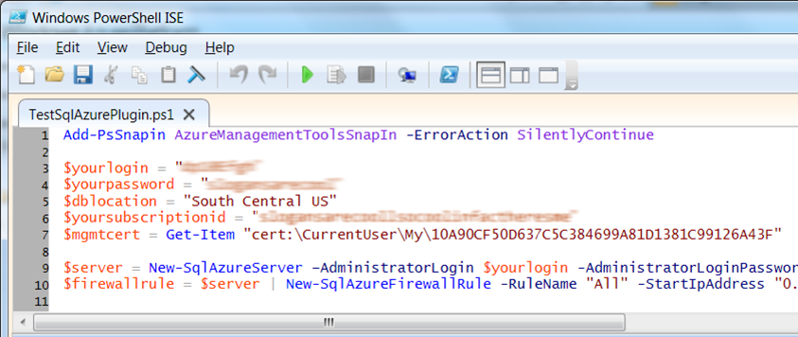
Automate Server Provisioning
Microsoft Azure Platform PowerShell cmdlets
http://bit.ly/azurepowershell
Notes:
Slide Objectives:
Show the different methods of provisioning a SQL Database server along with how easy it is. Plus, help the attendees understand what a SQL Database “server” really is.
Transition:
Provisioning an on-premises SQL Server box can be time consuming, costly, and at times, a challenge. With SQL Database, provisioning a “server” is painless, quick, and provisioned in a matter of seconds.
Speaking Points:
Provision servers interactively using the Management Portal
Automate server provisioning using the Microsoft Azure Management API or PowerShell.
Notes:
While the “server” is technically a TDS endpoint, much of the SQL Server process is similar. Administration login credentials are still needed for security, and more importantly defining service access is essential, and required, for maintaining the integrity of your server through firewall rules.

Slide 130
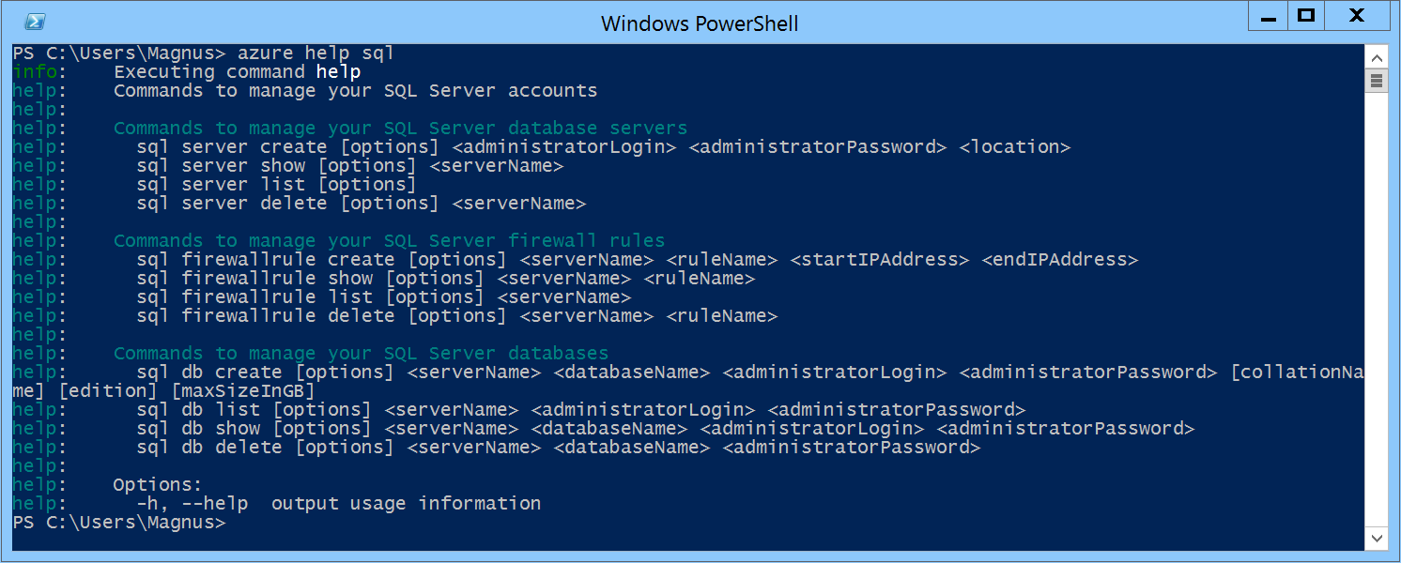
Automate Server Provisioning
Azure Cross-Platform Command-Line Interface (xplat-cli)
http://bit.ly/azurexplatcli
Notes:
Slide Objectives:
Show the different methods of provisioning a SQL Database server along with how easy it is. Plus, help the attendees understand what a SQL Database “server” really is.
Transition:
Provisioning an on-premises SQL Server box can be time consuming, costly, and at times, a challenge. With SQL Database, provisioning a “server” is painless, quick, and provisioned in a matter of seconds.
Speaking Points:
Automate server provisioning using the Microsoft Azure Management API or PowerShell or xplat-cli.

Slide 131
Demo: Creating A SQL Database Server and a SQL Database
Notes:
Demo 1)

Slide 132
Selecting the right SQL Database edition
Service Tier | Performance Level | Common App Pattern | Performance |  |  | Business Continuity
 |  |  | Max DB Size | Transaction Perf. Objective | DTU | PITR | DR / GEO-Rep
Basic | Basic | Small DB, SQL opp | 2 GB | Reliability / Hr. | 5 | 7 Days | DB Copy + Manual Export
Standard | S0 S1 S2 | Wrkgp/cloud app, multiple concurrent operations | 250 GB | Reliability / Min. | 10 20 50 | 14 Days | DB Copy + Manual Export
Premium | P1 P2 P3 | Mission Critical, High volume, Many concurrent Users | 500 GB | Reliability / sec. | 100 200 800 | 35 Days | Active Geo-replication
This information is subject to change over time.
Notes:
Slide Objectives:
Highlight what’s new in the latest SQL Database service update.
Transition:
In late September a service update was deployed to Microsoft Azure SQL Database that included new functionality.
Speaking Points:
Linked Server – This is a new component for database hybrid solutions spanning on-premises corporate networks and the Microsoft Azure cloud.
Recursive Trigger – Just like SQL Server 2012, the option can be configured via ALTER DATABASE dbname SET RECURSIVE_TRIGGERS ON|OFF
DBCC – The query optimizer uses statistics to estimate the cardinality or number of rows in the query result, which enables the query optimizer to create a high quality query plan.
Firewall Rules – different rules for different databases hosted on the same logical SQL Database server
Notes:

Slide 133
Auto backups, transactional logs every 5 min
Backups in Azure Storage and geo-replicated
Creates a side-by-side copy, non-disruptive
Backups retention policy: 7, 14 or 35 days
Automated export of logical backups for long-term backup protection
Point-in-time restore - “oops recovery”

Slide 134
Available in all tiers: Basic, Standard and Premium
Built on geo-redundant Azure Storage
Recover to any Azure region
Geo-restore – Emergency data recovery when you need it most
Notes:
Emergency data recovery when you need it most

Slide 135
Opt-in for Standard & Premium databases
Creates a stand-by secondary
Replicate to pre-paired Azure region
Automatic data replication, asynchronous
Opt-in via REST API, PowerShell or Azure Portal
Microsoft-managed, RTO<24h, RPO<1 hr
Standard geo-replication
Notes:
RTO Recovery time objective http://en.wikipedia.org/wiki/Recovery_time_objective
RPO Recovery point objective http://en.wikipedia.org/wiki/Recovery_point_objective

Slide 136
Self-service activation in Premium
Create up to 4 readable secondaries
Replicate to any Azure region
Automatic data replication, asynchronous
REST API, PowerShell or Azure Portal
RTO<1h, RPO<5m, you choose when to failover
Active geo-replication
Notes:
RTO Recovery time objective http://en.wikipedia.org/wiki/Recovery_time_objective
RPO Recovery point objective http://en.wikipedia.org/wiki/Recovery_point_objective

Slide 137
Configurable to track & log database activity
Dashboard views in the portal for at-a-glance insights
Pre-defined Power View reports for deep visual analysis on Audit log data
Audit logs reside in your Azure Storage account
Available in Basic, Standard, and Premium
Auditing
Notes:
Gain insight into database events & streamline compliance-related tasks

Slide 138
Full-Text Search
Fast and flexible indexing of textual data
Data types: char, varchar, nchar, nvarchar, text, ntext, image, xml, varbinary(max), or FILESTREAM
Handles high query volume
Common use cases:
Searching websites, product catalogs, news items and more
Document management systems
Any applications that need to provide search capabilities over data stored in a SQL Database
Notes:
Speaker notes:
Full-Text Search allows fast and flexible indexing for keyword-based query of text data stored in tables with columns of following data types: char, varchar, nchar, nvarchar, text, ntext, image, xml, or varbinary(max)
Full-text queries can include simple words and phrases or multiple forms of a word or phrase.
A full-text query returns any documents that contain at least one match (also known as a hit). A match occurs when a target document contains all the terms specified in the full-text query, and meets any other search conditions, such as the distance between the matching terms.
Full-text queries perform linguistic searches against text data in full-text indexes by operating on words and phrases based on rules of a particular language such as English or Japanese
A full-text query returns any documents that contain at least one match (also known as a hit). A match occurs when a target document contains all the terms specified in the full-text query, and meets any other search conditions, such as the distance between the matching terms.
Full-text search is applicable to a wide range of business scenarios such as e-businesses—searching for items on a web site; law firms—searching for case histories in a legal-data repository; or human resources departments—matching job descriptions with stored resumes.

Slide 139
XML Indexes
XML Indexes - improves XQuery-based query performance
Primary XML Index - speed up access to elements and attributes
CREATE PRIMARY XML INDEX XML_Order_Items
ON Sales.Order (Items);
Secondary XML Index – help resolve specific XQuery expressions rapidly
Notes:
Slide objective:
XML indexes speedup XQuery-based query response
Speaker notes:
An XML index is like a copy of an XML object tree that is saved into the database for rapid reuse rather than an object created in memory and traversed during query time which is a relatively slow process.
Before you can create a primary XML index on a table, the table must have a clustered primary key.
Secondary indexes are designed to speed up a particular type of query such as PATH, VALUE, and PROPERTY indexes:
A PATH index helps to decide whether a particular path to an element or attribute is valid. It is typically used with the exist() XQuery method.
A VALUE index helps to obtain the value of an element or attribute.
A PROPERTY index is used when retrieving multiple values through PATH expressions.

Slide 140
Dynamic Management Views (DMV)
Monitor common database, execution and transaction related events in near-real time
Diagnose blocked or long-running queries, resource bottlenecks, poor query plans, and more
Help improve capacity planning
Use familiar T-SQL language
Notes:
Slide objective:
Emphasize Azure SQL Database service has extremely rich environment for monitoring the status of your databases using DMVs.
Speaker notes:
Microsoft Azure SQL Database partially supports three categories of dynamic management views:
Database-related dynamic management views (indexes, partitions and waits)
Execution-related dynamic management views (connections, sessions, requests) Transaction-related dynamic management views (transactions and locks)
Identify expensive queries and gain an understanding of long running queries
View the status of your query within the execution plan
Detect the queries that run for long may be getting throttled by Azure SQL Database service
Monitor the size of transactions and transaction log usage
Helps with capacity planning - If these percentages remain near 100% utilization, you should consider improving performance by scaling out, scaling up, or optimizing your database design.

Slide 141
Demo: Connect from on premise and deploy your database
Notes:
Demo 2)

Slide 142
Use Familiar Technologies
Transact-SQL
(obviously)
Notes:
Slide Objectives:
Point out that 1) The same great technologies that developers use today on-premises works with SQL Database 2) high-level differences between on-premises and SQL Database 3) SQL Database features currently unsupported
Transition:
Creating, managing, and deploying a database in Microsoft Azure SQL Database isn’t difficult. The key is understanding the features that are supported and how SQL Database compares to on-premises SQL Server and the technologies that can be used with SQL Database.
Speaking Points:
The same great technologies that developers use today on-premises works with SQL Database, including developer languages, Frameworks, and Tools. Nothing new to learn!
SQL Server Comparison -> highlight the physical vs. logical administration. Developers and DBAs can now focus on things they love to do and not worry about the physical aspect.
Features unsupported by SQL Database -> Many of the unsupported features are hardware based and thus don’t need to be in SQL Database. Other features, such as encryption, are server-based and become a challenge in solving in a shared-environment.
Notes:
CLR data types ARE supported, SQLCLR is not yet supported.
Backup/Restore: PIT Coming; Import/Export can be used for backup to BLOB storage. Third-party backup products available via RedGate and Enzo.
Data can be stored encrypted but the encryption must be done at the application level.
Native encryption is being looked at.
**Linked Servers and Distributed Queries are now supported, linking a SQL Database instance from an on-premises server. Linking two SQL Database instances is NOT supported.

Slide 143
Use Familiar Technologies - Languages
.NET Framework (C#, Visual Basic, F#): ADO.NET
C / C++: ODBC
Java: Microsoft JDBC provider
PHP: Microsoft PHP provider
.NET Framework (C#, Visual Basic, F#): ADO.NET
C / C++: ODBC
Java: Microsoft JDBC provider
PHP: Microsoft PHP provider
Notes:
Slide Objectives:
Point out that 1) The same great technologies that developers use today on-premises works with SQL Database 2) high-level differences between on-premises and SQL Database 3) SQL Database features currently unsupported
Transition:
Creating, managing, and deploying a database in Microsoft Azure SQL Database isn’t difficult. The key is understanding the features that are supported and how SQL Database compares to on-premises SQL Server and the technologies that can be used with SQL Database.
Speaking Points:
The same great technologies that developers use today on-premises works with SQL Database, including developer languages, Frameworks, and Tools. Nothing new to learn!
SQL Server Comparison -> highlight the physical vs. logical administration. Developers and DBAs can now focus on things they love to do and not worry about the physical aspect.
Features unsupported by SQL Database -> Many of the unsupported features are hardware based and thus don’t need to be in SQL Database. Other features, such as encryption, are server-based and become a challenge in solving in a shared-environment.
Notes:
CLR data types ARE supported, SQLCLR is not yet supported.
Backup/Restore: PIT Coming; Import/Export can be used for backup to BLOB storage. Third-party backup products available via RedGate and Enzo.
Data can be stored encrypted but the encryption must be done at the application level.
Native encryption is being looked at.
**Linked Servers and Distributed Queries are now supported, linking a SQL Database instance from an on-premises server. Linking two SQL Database instances is NOT supported.

Slide 144
Use Familiar Technologies - Frameworks
OData
Entity Framework
WCF Data Services
NHibernate (etc.)
Notes:
Slide Objectives:
Point out that 1) The same great technologies that developers use today on-premises works with SQL Database 2) high-level differences between on-premises and SQL Database 3) SQL Database features currently unsupported
Transition:
Creating, managing, and deploying a database in Microsoft Azure SQL Database isn’t difficult. The key is understanding the features that are supported and how SQL Database compares to on-premises SQL Server and the technologies that can be used with SQL Database.
Speaking Points:
The same great technologies that developers use today on-premises works with SQL Database, including developer languages, Frameworks, and Tools. Nothing new to learn!
SQL Server Comparison -> highlight the physical vs. logical administration. Developers and DBAs can now focus on things they love to do and not worry about the physical aspect.
Features unsupported by SQL Database -> Many of the unsupported features are hardware based and thus don’t need to be in SQL Database. Other features, such as encryption, are server-based and become a challenge in solving in a shared-environment.
Notes:
CLR data types ARE supported, SQLCLR is not yet supported.
Backup/Restore: PIT Coming; Import/Export can be used for backup to BLOB storage. Third-party backup products available via RedGate and Enzo.
Data can be stored encrypted but the encryption must be done at the application level.
Native encryption is being looked at.
**Linked Servers and Distributed Queries are now supported, linking a SQL Database instance from an on-premises server. Linking two SQL Database instances is NOT supported.

Slide 145
Use Familiar Technologies - Tools
SQL Server Management Studio (>=2008 R2)
SQL Server command-line utilities (SQLCMD, BCP)
Visual Studio IDE for database development
Notes:
Slide Objectives:
Point out that 1) The same great technologies that developers use today on-premises works with SQL Database 2) high-level differences between on-premises and SQL Database 3) SQL Database features currently unsupported
Transition:
Creating, managing, and deploying a database in Microsoft Azure SQL Database isn’t difficult. The key is understanding the features that are supported and how SQL Database compares to on-premises SQL Server and the technologies that can be used with SQL Database.
Speaking Points:
The same great technologies that developers use today on-premises works with SQL Database, including developer languages, Frameworks, and Tools. Nothing new to learn!
SQL Server Comparison -> highlight the physical vs. logical administration. Developers and DBAs can now focus on things they love to do and not worry about the physical aspect.
Features unsupported by SQL Database -> Many of the unsupported features are hardware based and thus don’t need to be in SQL Database. Other features, such as encryption, are server-based and become a challenge in solving in a shared-environment.
Notes:
CLR data types ARE supported, SQLCLR is not yet supported.
Backup/Restore: PIT Coming; Import/Export can be used for backup to BLOB storage. Third-party backup products available via RedGate and Enzo.
Data can be stored encrypted but the encryption must be done at the application level.
Native encryption is being looked at.
**Linked Servers and Distributed Queries are now supported, linking a SQL Database instance from an on-premises server. Linking two SQL Database instances is NOT supported.

Slide 146
Unsupported SQL Server Features
Use command, distributed transactions, distributed views
Service Broker
SQL Agent
SQL Profiler
Native Encryption
Notes:
Slide Objectives:
Point out that 1) The same great technologies that developers use today on-premises works with SQL Database 2) high-level differences between on-premises and SQL Database 3) SQL Database features currently unsupported
Transition:
Creating, managing, and deploying a database in Microsoft Azure SQL Database isn’t difficult. The key is understanding the features that are supported and how SQL Database compares to on-premises SQL Server and the technologies that can be used with SQL Database.
Speaking Points:
The same great technologies that developers use today on-premises works with SQL Database, including developer languages, Frameworks, and Tools. Nothing new to learn!
SQL Server Comparison -> highlight the physical vs. logical administration. Developers and DBAs can now focus on things they love to do and not worry about the physical aspect.
Features unsupported by SQL Database -> Many of the unsupported features are hardware based and thus don’t need to be in SQL Database. Other features, such as encryption, are server-based and become a challenge in solving in a shared-environment.
Notes:
CLR is now supported: http://azure.microsoft.com/blog/2014/12/11/preview-available-for-next-generation-of-azure-sql-database/
Backup/Restore: PIT Coming; Import/Export can be used for backup to BLOB storage. Third-party backup products available via RedGate and Enzo.
Data can be stored encrypted but the encryption must be done at the application level.
Native encryption is being looked at.
**Linked Servers and Distributed Queries are now supported, linking a SQL Database instance from an on-premises server. Linking two SQL Database instances is NOT supported.

Slide 147
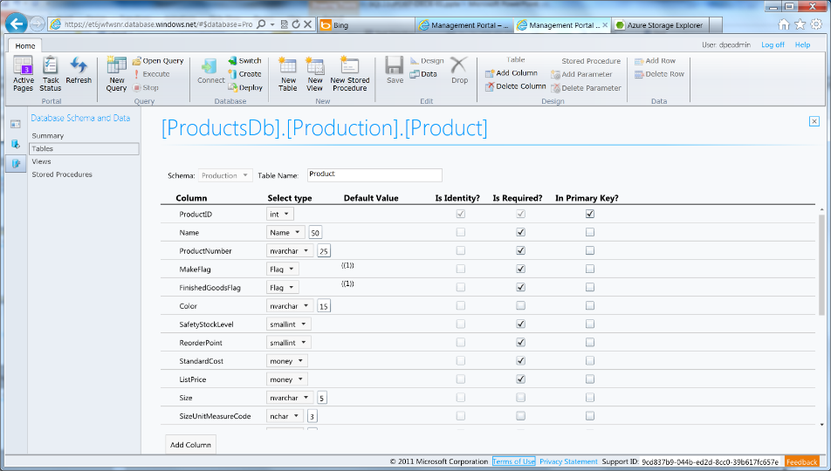
Azure SQL Database Management Portal
Web designers for tables, views, stored procs
Interactive query editing and execution
Notes:
Slide Objectives:
Highlight the set of tools for developers when interacting with Microsoft Azure SQL Database.
Transition:
Transition statement(s) to setup the slide
Speaking Points:
SQL Database Management Portal -> Cross Browser, Unified Management Experience
SQL Server Data Tools -> Integrated Database Design Environment, Table Designer, Debugging, T-SQL Editor
Notes:
IntelliSense in T-SQL Editor
SQL Server Data Tools
Strive to make it consistent as possible
Intersection with the cloud
Bridging you to the new cloud world
Consistency to the new developer experience
Consistency with the new cloud model

Slide 148
Demo: DAC Deployment From SQL Server Management Studio
Notes:
Demo 3)

Slide 149

Elastic Database

Slide 150


Elastic Database Pool
Elastic Database
Pool
Elastic Database
Predictable model for deploying large numbers of databases
Notes:
Speaker notes:
Elastic pools simplify the process of creating, maintaining, and managing both performance and cost for large numbers of Azure SQL databases.
Manage large numbers of databases that have unpredictable resource demands.
Ability to run centralized queries and reporting tools across database pool.

Slide 151
PREVIEW
Elastic Database Model
Elastic databases, Elastic database pools
Pooled resources leveraged by many databases
Standard elastic pool provides 200-1200* eDTUs for up to 100* databases
Elastic Standard databases can burst up to 100 eDTUs (S3 level)
Create/configure pool via portal, PowerShell, REST APIs
Move databases in/out using portal, PowerShell, REST APIs, T-SQL
Databases remain online throughout
Monitoring and alerting is available on both pool and databases
Max per-database burst level
eDTUs
200
400
800
1200
*Additional pricing tiers may be introduced, and the ranges and limits may be increased during the preview

Slide 152
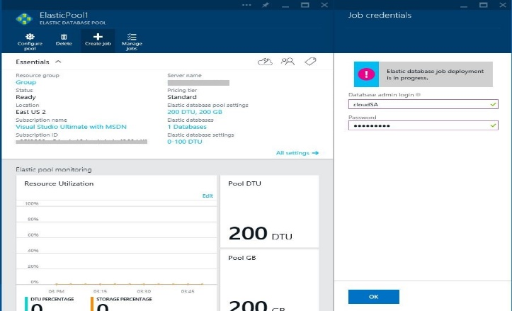
Elastic Database Jobs
ELASTIC DATABASE JOBS
SQL
SQL
SQL
T-SQL Scripts
SQL
ELASTIC DATABASE POOL
Execute administrative tasks across each database
Notes:
Speaker notes:
Execute administrative tasks across each database
Don’t have to connect to each database independently in order to run T-SQL statements or perform other administrative tasks
For example, you can easily update the schema in every database to include a new table
Elastic database jobs handles the task of logging in, and reliably running the script for you, while logging the status of execution for each database

Slide 153
Managing many databases
Apply changes or administrative operations to many databases
Use familiar T-SQL scripts to define jobs
Built-in automatic retries in case of transient failures
Tightly integrated with elastic pools in the new Azure Portal
Designed for batch processing
Elastic Database Jobs

Slide 154
Elastic Scale
Notes:
This section is optional. If you have an audience with a specific interest in this there are many more slides hidden in a section at the end!

Slide 155
Canonical cloud app architecture
Classic 3-tier enterprise architecture:
Scale out the front ends to multiple instances is easy
Scale the data-tier is more challenging
Notes:
Classic 3-tier enterprise architecture
Requires to scale to 10000s users and process TBs of relational data
Scaling out (and in, elastically) web and worker tiers is relatively easy
How to scale data-tier if hard limits of the biggest scale unit (e.g. P3 instance) are reached: both storage size and throughput?

Slide 156
SQL Database Considerations and Best Practices
Elastic Scale across thousands of databases via custom sharding
Scale out via .NET Client libraries consumed by customer applications to support sharded database pattern
Enables developer and manageability functions
Supports split, merge, and move operations on data

Slide 157
Scalability options in Azure SQL DB
Vertical: Scale-up or scale-down
Horizontal: Scale-out or scale-in
Premium
Premium
Standard
Standard
Scale up/down
Basic
Basic
Basic
Basic
Basic
Basic
Basic
Scale out/in
Notes:
Vertical: Change service-tiers for a given database as capacity needs fluctuate
Horizontal: Add or remove databases as more or less capacity is needed
Animation:
We start off with 3 basic databases
[click]: We can vertically scale one of these to a standard instance
[click]: We can also add more instances by scaling horizontally
[click]: If an instance need more headroom, we can always still vertically scale

Slide 158
Elastic Scale architecture

Slide 159
SQL Server VM
Notes:
Now let’s focus on SQL Server in a Microsoft Azure Virtual Machine!

Slide 160
Run SQL on VM
Run any SQL product on cloud VM
Support for SQL Server, Oracle, MySql
Ready to go VM images available in Gallery
Persistent storage using attached disk in blob storage
Has all the benefits and powers of VMs combined with the full features of a SQL Engine

Slide 161
Why (at least) two offerings of SQL in Azure?
SQL IaaS
SQL Database

Slide 162
SQL Database
SQL IaaS
When you want reduced overhead and possibly need elastic scale.
Customer does not want to add additional IT resources for support and maintenance.
Avoiding CAPEX and OPEX.
Existing applications which requires full box product functionality.
Customer has ecosystem of IT resources for support and maintenance.
Removing CAPEX.

Slide 163
Other features SQL IaaS supports that SQL Database doesn’t (yet)
Full SQL Server functionality (e.g. Reporting Services)
Windows authentication available (requires VM to be joined to on-premises domain)
Larger database sizes possible (16TB)
Notes:
Note: Full-Text Search now supported https://msdn.microsoft.com/library/ms142571.aspx

Slide 164

Redis Cache

Slide 165
Document DB

Slide 166
Microsoft Azure DocumentDB
Notes:
Extra DocumentDB slides

Slide 167

DocumentDB Overview
A NoSQL document database-as-a-service, fully managed by Microsoft Azure.
For cloud-designed apps when query over schema-free data; reliable and predictable performance; and rapid development are key. First of its kind database service to offer native support for JavaScript, SQL query and transactions over schema-free JSON documents.
Perfect for cloud architects and developers who need an enterprise-ready NoSQL document database.
Rich Query and Transactions
over Schema-free Data
Reliable &
Predictable Performance
Rapid Development
Query schema-free data with no secondary indices
Native JavaScript transactional processing
Familiar SQL-based query language
Fast, predictable performance
Tunable consistency
Elastic scale
Build with familiar tools – REST, JSON, JavaScript
Easy to start and fully-managed
Enterprise-grade Azure platform
Release Timing
Public Preview: August 21, 2014
GA: H2 FY15

Slide 168
Proven @ Scale
Data store powering production Microsoft services.
Scale tested with databases over 10TBs of JSON document data from Office OneNote API service
Rapidly evolving data models and query patterns based on 3rd party applications
Serving over 1 million active users
Operating consistently with 99.95% availability
First Party Use Cases
Store, roam and query user generated data across applications
Extensible data models for 3rd party integration
Social activity and awareness feeds with views and filtering

Slide 169
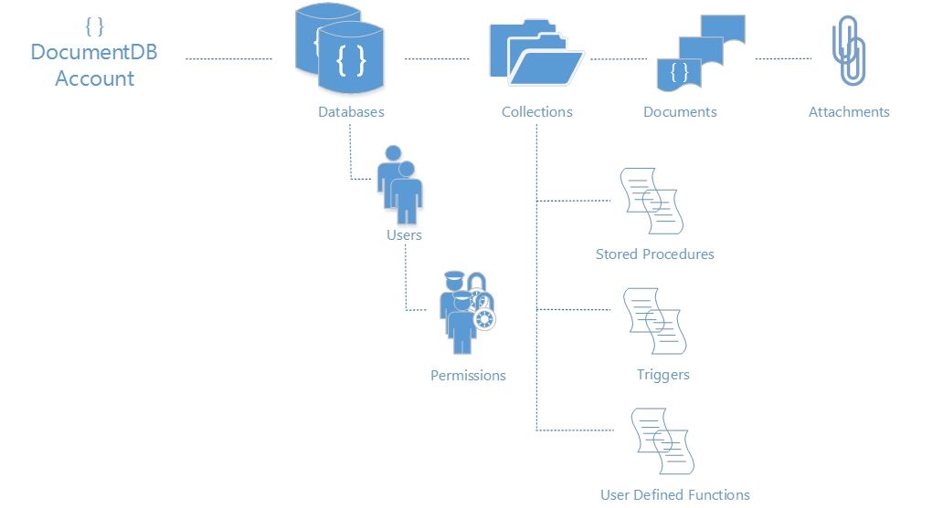
Microsoft Azure DocumentDB
{ “topic” : “resource model”}
Resource Model
Simple HTTP RESTful programming model.
All entities uniquely addressable by a logical URI.
Standard HTTP verbs and semantics – PUT, POST, PATCH, DELETE, GET, HEAD
Partitioned for scale out and replicated for HA
Granular access control through item level permissions
Attachments stored in Azure Blobs and follow document lifecycle
DocumentDB accounts scale out through the addition of capacity units with associated DB storage and throughput
https://myaccountname.documents.azure.net/dbs/{id}/colls/{id}/docs/{id}
/dbs/{id}
/colls/{id}
/docs/{id}
/attachments/{id}
/users/{id}
/sprocs/{id}
/triggers/{id}
/functions/{id}

Slide 170
Interaction Model
RESTful interaction model over HTTP (and TCP)
Database access methods exposed using standard HTTP verbs & semantics
Stateless interaction with built-in rate limiting and retry
Interact using your favorite HTTP client
Designed for Gateway as well as, Direct Connectivity options
Resource
POST
Tenant
Resource set
Insert
Resource
PUT
Resource
Replace
DELETE
Resource
POST http://myaccount.documents.azure.net/dbs
{ “id":"My Company Db"}
...
[201 Created]
{
“id": "My Company Db",
“_rid": "UoEi5w==",
“_self": "dbs/UoEi5w==/",
“_colls": "colls/",
“_users": "users/"
}
Delete
GET
Tenant
Resource set
Enumerate
SQL
POST
Tenant
Documents
Query
args
POST
Tenant
sproc results
Execute

Slide 171
LINQ Query
Query
// book.Title lookup against automatic server index
from book in client.CreateDocumentQuery<Book>(collectionSelfLink)
where book.Title == "War and Peace" select book;
// Nested book.Author.Name also indexed!
from book in client.CreateDocumentQuery<Book>(collectionSelfLink)
where book.Author.Name == "Leo Tolstoy"
select book.Author;
// Array lookups
from book in client.CreateDocumentQuery<Book>(collectionSelfLink)
where book.Languages.Any(lng => (lng.Name == "English"))
select book;
Query over heterogeneous documents without defining schema or managing indexes
Query arbitrary paths, properties and values without specifying secondary indexes or indexing hints
Execute queries with consistent results in the face of sustained writes
Query through fluent language integration including LINQ for .NET developers and a “document oriented“ SQL grammar for traditional SQL developers
Extend query execution through application supplied JavaScript UDFs
Supported SQL features at Preview; predicates, iterations (arrays), sub-queries, logical operators, UDFs, intra-document JOINs, JSON transforms
SQL Query Grammar
-- Nested lookup against index
SELECT B.Author
FROM Books B
WHERE B.Author.Name = "Leo Tolstoy"
-- Transformation, Filters, Array access
SELECT { Name: B.Title, Author: B.Author.Name }
FROM Books B
WHERE B.Price > 10 AND B.Language[0] = "English"
-- Joins, User Defined Functions (UDF)
SELECT CalculateRegionalTax(B.Price, "USA", "WA")
FROM Books B
JOIN L IN B.Languages
WHERE L.Language = "Russian"
The “write” index for consistent queries
highly concurrent, lock free, log structured indexing technology developed with Microsoft Research
Optimized for SSD (works well for HDD)
Resource governed for tenant isolation

Slide 172
Transactions and JavaScript App Logic
Familiar Programming Model
Stored Procedures
Triggers
UDFs
Language Integrated transactions
JavaScript as a modern day T-SQL
The entire procedure is wrapped in an implicit ACID transaction
JavaScript throw statement results into aborting the transaction
Pre-compiled on registration
Resource Governed & Sandboxed
No imports are allowed
Eval() is disallowed
Execution is time boxed
Governed for CPU, IO and memory
Stored Procedures
client.executeStoredProcedureAsync ("procs/1234", "MasterChief", "SolidSnake") .then(function (response) { console.log(“success!"); }, function (err) { console.log("Failed to swap!", error); });
function(playerId1, playerId2) { var collection = getContext().getCollection();
var playersToSwap = collection.filterDocuments(function (document) { return (document.id == playerId1 || document.id == playerId2); });
var player1 = playersToSwap[0], player2 = playersToSwap[1]; var player1ItemTemp = player1.item; player1.item = player2.item; player2.item = player1ItemTemp;
collection.replaceDocument(player1) .then(function() { return collection.replaceDocument(player2); }) .fail(function(error){ throw 'Unable to update players, abort'; }); }

Slide 173
Programmability
client = new DocumentClient(new Uri(endpointUrl), authKey);
Database database = await client.CreateDatabaseAsync(new Database{Id = “myNewDatabase”});
DocumentCollection collection = await client.CreateDocumentCollectionAsync(database.SelfLink, new DocumentCollection{Id = “Pages"});
Page page = new Page
{
Id = "Sample",
Title = "About Paris",
Language = new Language { Name = "English" },
Author = new Author { Name = "Don” },
Content = "Don's document in DocDB is a valid JSON document",
PageViews = 10000,
Topics = new Topic[] {
new Topic { Title = "History" },
new Topic { Title = "Places to see" }}
};
ResourceResponse<Document> resp = await client.CreateDocumentAsync(collection.DocumentsLink, page);
Broad language and platform support
REST/HTTP APIs
C#, Node.js, JavaScript and Python SDKs for Public Preview
SDKs open sourced through GitHub
C# Client SDK
Supports gateway and direct connectivity
Async APIs for all operations
HTTP and TCP transports available
POCOs, inherited document types and dynamics
LINQ provider for query execution

Slide 174
Pricing principles
Capacity Units are combinable
Storage, request units/second, and price scale linearly
provisioned capacity units
throughput
Request units per second
db storage
GB
Notes:
Before we get into the detail of how unique and transformative DocDB is, I’d like to point out that we have made buying and scaling the service very simple.
You buy DocDB in units. Each unit has 10GB of storage and 2000 request units per second. Think of request units as a form of currency where each request to the system has a cost and you get 2000 of these per second. Some examples of costs are:
Reading a single document
2000 reads
Inserting/Replacing/Deleting a single document
500 inserts/replace/deletes
Query a collection with a simple predicate and returning a single document
1333 queries
Stored Procedure a 50 document inserts
1000 inserts
Your database is automatically replicated to provide high availability. When you need more storage or more throughput, you just buy another unit. You then have twice as much storage and twice as many requests per second. DocumentDB storage and throughput scales linearly with cost. There is virtually no limit to the size of the database that it can scale to, although for Preview, we are limiting it to 5 units per database account. If you have a customer that needs more, just get in touch and we can remove that limit.

Slide 175
10GB database storage^{1,2}
2000Request units per second
$22.50/month
Discounted 50% for Preview
Standard Offer for Preview
Attached BLOB storage not included in db storage.
Storage is inclusive of document data and indexes; we will provide guidance on limits for other DB entities.
Notes:
Before we get into the detail of how unique and transformative DocDB is, I’d like to point out that we have made buying and scaling the service very simple.
You buy DocDB in units. Each unit has 10GB of storage and 2000 request units per second. Think of request units as a form of currency where each request to the system has a cost and you get 2000 of these per second. Some examples of costs are:
Reading a single document
2000 reads
Inserting/Replacing/Deleting a single document
500 inserts/replace/deletes
Query a collection with a simple predicate and returning a single document
1333 queries
Stored Procedure a 50 document inserts
1000 inserts
Your database is automatically replicated to provide high availability. When you need more storage or more throughput, you just buy another unit. You then have twice as much storage and twice as many requests per second. DocumentDB storage and throughput scales linearly with cost. There is virtually no limit to the size of the database that it can scale to, although for Preview, we are limiting it to 5 units per database account. If you have a customer that needs more, just get in touch and we can remove that limit.

Slide 176
Request Units
Request units are provisioned for each database account based on the number of capacity units purchased.
Request unit consumption is evaluated as a rate per second.
Applications that exceed the provisioned request unit rate for their account will be throttled until the rate drops below the reserved level for the Account.
If your application requires a higher level of throughput, you can purchase additional capacity units.

Slide 177
Request Units
Database Operations | Operations/sec/capacity unit
Reading a single document | 2000 reads
Inserting/Replacing/Deleting a single document | 500 inserts/replace/deletes
Query a collection with a simple predicate and returning a single §document | 1000 queries
Stored Procedure a 50 document inserts | 20 stored procedures

Slide 178
Fully managed, scalable JSON document database service

Slide 179
DocumentDB
Notes:
Now let’s focus on the new Microsoft Azure DocumentDB Service!

Slide 180
Fully managed, scalable JSON document database service

Slide 181
Microsoft Azure Data Services
SQL Server in a VM
SQL Database
DocumentDB
Tables
Blobs
fully managed, scalable, queryable, schemafree JSON document database service for modern applications
fully featured RDBMS
transactional processing
rich query
managed as a service
elastic scale
schema-free data model
internet accessible http/rest
arbitrary data formats

Slide 182
MongoDB
DocumentDB
Existing applications which require extra capacity for scale out and can not be migrated
Customer has ecosystem of IT resources for support and maintenance
Removing CAPEX
Mongo MMS compatibility
Applications that need managed elastic scale, query over schema free data, native JSON/JavaScript support
Customer does not want to add additional IT resources for support and maintenance
Avoiding CAPEX and OPEX
Built-for-the-cloud database technology

Slide 183
Tunable Consistency – four distinct levels
Strong Bounded Stateless Session Eventual
Notes:
Configurable consistency to trade off consistency and performance.
Database Accounts are configured with a default consistency level.
Consistency level can be weakened per read/query request.

Slide 184
Tunable Consistency Strong
All writes are visible to all readers. Writes synchronously committed by a majority quorum of replicas and reads are acknowledged by the majority read quorum.

Slide 185
Tunable Consistency Bounded Stateless
Guaranteed ordering of writes, reads adhere to minimum freshness. Writes are propagated asynchronously, reads are acknowledged by majority quorum lagging by at most K prefixes.

Slide 186
Tunable Consistency Session
Read your own writes. Writes are propagated asynchronously while reads for a session are issued against the replica that can serve the requested version.

Slide 187
Tunable Consistency Eventual
Reads eventually converge with writes. Writes are propagated asynchronously while reads can be acknowledged by any replica. Readers may view older data then previously observed.

Slide 188
Tunable Consistency
 | Writes | Reads
Strong | sync quorum writes | quorum reads
Bounded | async replication | quorum reads
Session | async replication | session bound replica
Eventual | async replication | any replica
*
* | Ideal consistency and performance tradeoff for many application scenarios. High performance writes and reads with predictable consistency.

Slide 189
Partitioning Data
Hash Range Lookup
Notes:
Speaker notes:
Achieve near-infinite scale in terms of storage and throughput by horizontally partitioning data(sharding)
Best partition option for data across collections will depend on data format and access patterns
DocumentDB accounts can be scaled linearly with cost via collections

Slide 190
Partitioning Hash
Partitions are assigned based on the value of a hash function, allowing you to evenly distribute requests and data across a number of partitions
Notes:
Speaker notes:
This is commonly used to partition data produced or consumed from a large number of distinct clients, and is useful for storing user profiles, catalog items, and IoT ("Internet of Things") telemetry data.
You should use hash partitioning whenever there are too many entities to enumerate through lookup partitioning (e.g. users or devices) and the request rate is fairly uniform across entities.
Hash partitioning is useful for uniform load balancing of requests to make effective use of your provisioned storage and throughput. Using consistent hashing algorithms allow you to minimize the amount of data that has to be moved when adding or removing a partition.

Slide 191
Partitioning Range
Partitions are assigned based on whether the partition key is within a certain range.
Notes:
Speaker notes:
This is commonly used for partitioning with time stamp properties (e.g., eventTime between Feb 1, 2015 and Feb 2, 2015).
You should use Range partitioning if your queries are restricted to specific range values against the partition key.
Range partitioning is generally used in the context of dates, as it gives you an easy and natural mechanism for aging out partitions by timestamp. It is also useful when queries are generally constrained to a time range since that is aligned with the partitioning boundaries.

Slide 192
Partitioning Lookup
Partitions are assigned based on a lookup map that assigns discrete partition values to specific partitions a.k.a. a partition or shard map.
Notes:
Speaker notes:
This is commonly used for partitioning by region (e.g. the partition for Scandinavia contains Norway, Denmark, and Sweden).
Lookup partitioning offers the highest degree of control in managing a multi-tenant application. You can assign multiple tenants to a single collection, single tenant to a single collection, or even a single tenant across multiple collections.
Lookup partitioning allows you to group and organize unordered and unrelated sets of data in a natural way e.g., group tenants by organization or states by geographic region. Lookup also offers fine-grained control for migrating data between collections.

Slide 193
Microsoft Azure DocumentDB
<Presenter name and role>

Slide 194
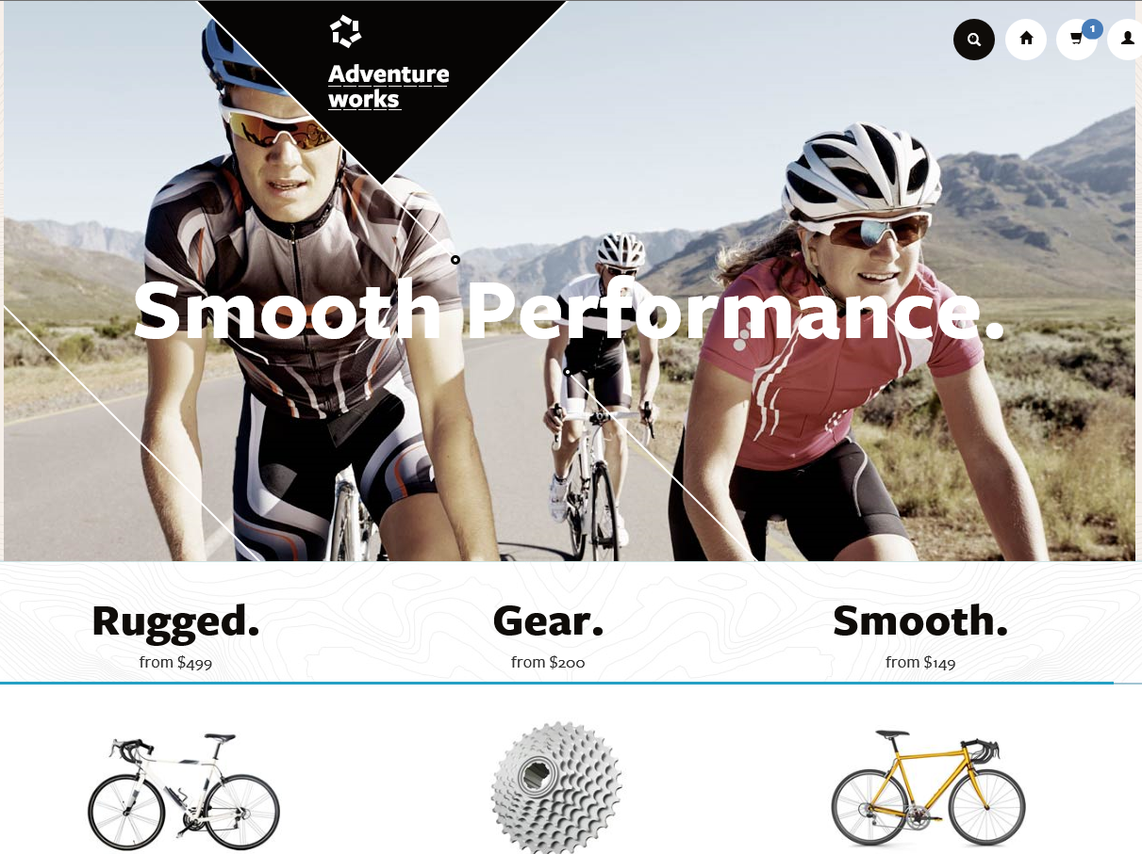
Today’s Modern Apps
Produce and consume data at a staggering rate while requiring instantaneous response times to match user expectations
Developed iteratively with many versions supported concurrently and continuously evolving data models
Increasingly complex, compensating for the lack of query and transactional processing in today’s NoSQL database systems
Experience unpredictable and explosive growth
Notes:
Now there are certain trends in modern application development that have surfaced in the last few years. These are - “Applications which…”
There are existing Azure services that meet the needs of one or more of the scenarios on this list, but DocumentDB meets the requirements demanded by all of these trends. DocumentDB fills a gap in the Azure data services portfolio.
We heard from internal and external customers that they didn’t want to run and manage NoSQL document stores especially at massive scale. Customers also told us they needed more of the query and transaction processing capabilities that are inherent to relational systems. So we considered what it would take to build a schema-free database with robust query and transaction processing using modern data formats, languages and protocols – the result of this effort is DocumentDB

Slide 195
DocumentDB is particularly suited for web and mobile applications
Catalog data
Preferences and state
Event store
User generated content
Data exchange
Notes:
So speaking of customers, let’s move on to some of the scenarios that we’ve seen DocDB used for. DocDB is particularly suited for web and mobile application development of all types, but a few scenarios seem to be great fit for the service and we’ve seen these scenarios in the private preview.
Catalog Data
Store, query and process entities – people, places, things
Evolve item schema and attributes based on application needs
Tune indexing to match query and performance needs
Examples include product catalogs, user profiles, device information i.e. IoT systems
Preferences and State
Store user preference data for application experiences and UI customization
Store application information including game state or device configuration information
Support cross document transactions i.e. item transfer or concurrent add/remove operations
Event Store
Process store and query device and application events in near real time i.e. IoT systems
Partition data as time-series or by source ID
Expose web APIs and application experiences over event data with diverse structure
Archive or delete data as it ages out
User Generated Content
Store user generated content such as blogs, comments, annotations.
Support varying properties based on consumption platform (web, mobile)
Rapidly evolve schema based on application needs
Data Exchange
Consume, aggregate and serve data from a variety of sources
Adapt to evolving schemas
Offer queries over heterogeneous document structures
Scale data consumption or delivery from disparate sources

Slide 196





How do we think about the different services?
SQL Server in a VM
SQL Database
DocumentDB
HBase
Tables/Blobs
fully featured RDBMS
rich query
transactional processing
managed as a service
elastic scale
schema-free data model
internet accessible http/rest
arbitrary data formats
Notes:
Presenter guidance:
Introduce the family portrait.
Slide talk track:
This is how we think about the core differences across the data services for capturing and managing data
On the left, you have more database imposed structure on the left and this loosens as you move to the right, ending in blobs which is just large containers of binary data.

Slide 197


Microsoft Azure DocumentDB
Microsoft Azure DocumentDB
{ “topic” : “intro”}
SQL Server in a VM
SQL Database
DocumentDB
HBase
Tables/Blobs
{ }
schema free query |  | Relational and hierarchical query of application defined JSON data. Support for SQL queries with transforms, projections and inline evaluation of user defined JavaScript functions (UDFs). Automatic and consistent indexing of all properties.
JavaScript as a modern T-SQL |  | Transactional execution of application defined stored procedures and triggers directly against database collections. Native JavaScript support eliminating the impedance mismatch between application and database schema.
tunable consistency |  | Well defined consistency levels to achieve optimal tradeoff between consistency and performance. Four distinct consistency levels for queries and read – Strong, Bounded-Staleness, Session and Eventual. Granular control over consistency, availability and latency
fully managed |  | Simple to provision and access databases without managing VM or cluster infrastructure. Operated with 99.95% availability and automatically backed up to prevent against regional failures

Slide 198
DocumentDB
NoSQL document database-as-a-service
First of its kind database service to offer native support for JavaScript, SQL query and transactions over JSON documents.
Rich Query and Transactions
over JSON Data
Reliable &
Predictable Performance
Rapid Development
Query JSON data with no secondary indices
Native JavaScript transactional processing
Familiar SQL-based query language
Fast, predictable performance
Tunable consistency
Elastic scale
Build with familiar tools – REST, JSON, JavaScript
Easy to start and fully-managed
Enterprise-grade Azure platform
Notes:
So what is DocumentDB?
DocumentDB is a NoSQL document database-as-a-service, fully managed by Microsoft Azure.
It is for cloud-designed apps when query over schema-free data; reliable and predictable performance; and rapid development are key. It’s the first of its kind database service to offer native support for JavaScript, SQL query and transactions over JSON documents.
The key benefits of DocDB can be broken down into three pillars. We'll go into a bit more detail into how DocDB is differentiated in the market based on these pillars.
Rich query and transaction over JSON data – which includes the concepts of query, automatic indexing, transactions, sql-like query language
Reliable and Predictable Performance – built for the cloud, tunable consistency, elastic
Rapid Development – benefits of being part of Azure, build with familiar tools (so you can bring your JSON data and take it away)
Together, you have a service that is perfect for cloud architects and developers who need an enterprise-ready NoSQL document database.

Slide 199
DocumentDB: A Document Store
DocumentDB
Collections
Document 1
Document 2
{
"name": "John",
"country": "Canada",
"age": 43,
"lastUse": "March 4, 2014"
}
{
"name": "Eva",
"country": "Germany",
"age": 25
}
SQL query
Application
Document 3
Document 4
JSON
Application
{
"name": "Lou",
"country": "Australia",
"age": 51,
"firstUse": "May 8, 2013"
}
{
"docCount": 3,
"last": "May 1, 2014"
}
Notes:
Source: https://msdn.microsoft.com/en-us/library/azure/dn781482.aspx
Microsoft Azure DocumentDB is a document-oriented, NoSQL database service designed for modern mobile and web applications. DocumentDB delivers consistently fast reads and writes, schema flexibility, and the ability to easily scale a database up and down on demand. DocumentDB enables complex ad hoc queries using a dialect of SQL, supports well defined consistency levels, and offers JavaScript language integrated, multi-document transaction processing using the familiar programming model of stored procedures, triggers and UDFs.

Slide 200

DocumentDB at Microsoft
over 425 million unique users
store 20TB of JSON document data
available globally to serve all markets
user data store
store for 40+ app / device combinations
under 15ms writes and single digit ms reads

Slide 201
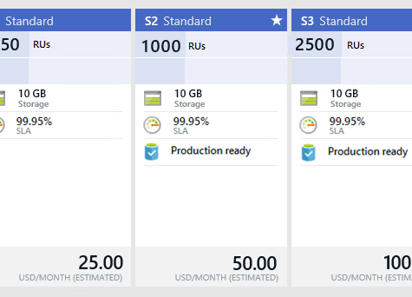
What Does DocumentDB Cost?
Pricing for General Availability
Standard pricing tier with hourly billing
S1, S2 and S3 units differentiated by performance (good, better, best)
Performance levels assigned during collection (data partition) creation
Performance levels can be adjusted based on application needs
Each collection includes 10GB of SSD storage
Limit of 100 collections (1 TB) for each account – can be lifted as needed
Notes:
Source: http://azure.microsoft.com/en-us/pricing/details/documentdb/
DocumentDB is a highly scalable, NoSQL document database service offering rich query and transactional processing over a schema-free JSON data model. The service helps you quickly build, grow, and scale applications that run in the cloud when predictable throughput, low latency, and flexible queries are key.

Slide 202
Provision a DocumentDB Account

Slide 204
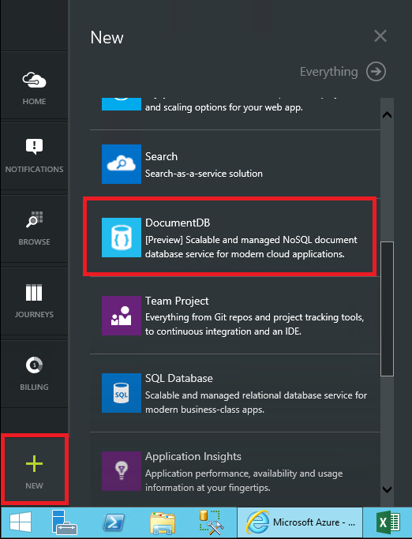
Create a New Account
Start from the Azure Portal to create a DocumentDB service
Notes:
Source: http://azure.microsoft.com/en-us/documentation/articles/documentdb-create-account/

Slide 205
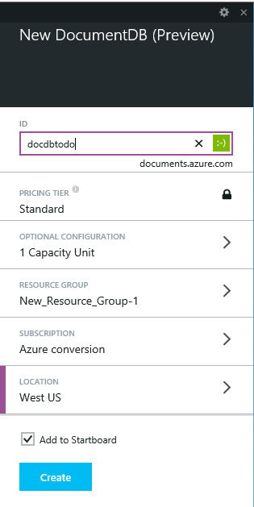
Provide the Service Name
Provide a name for your service that will be used as part of the endpoint URI
Define resource groups, capacity units, and service location
Notes:
Source: http://azure.microsoft.com/en-us/documentation/articles/documentdb-create-account/

Slide 206
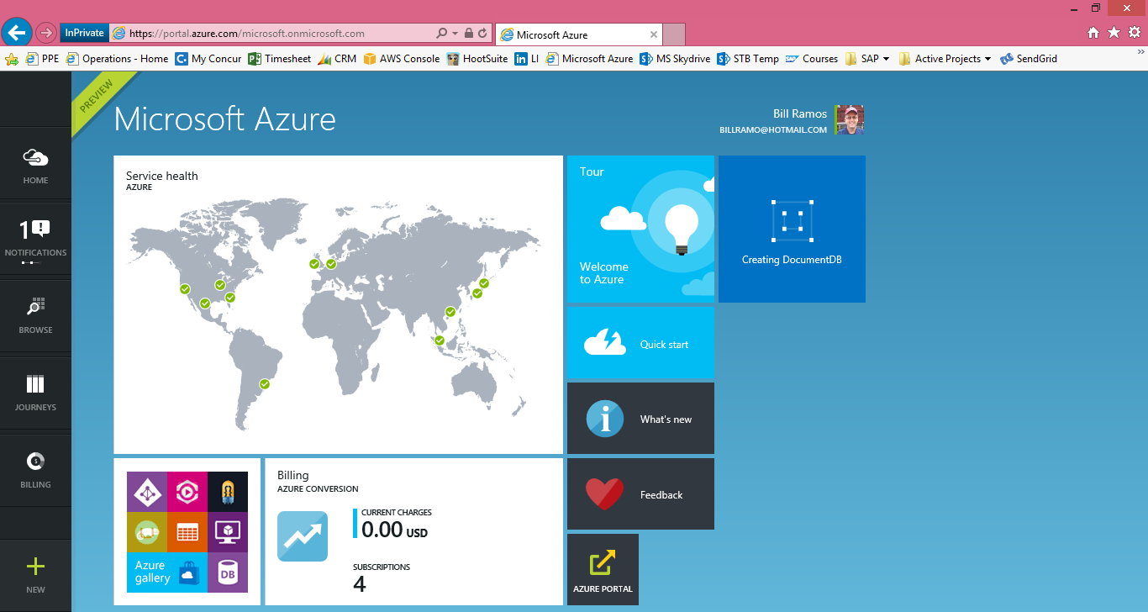
Complete Provisioning
The Azure portal provides notifications to let you know the provisioning status
Notes:
Source: http://azure.microsoft.com/en-us/documentation/articles/documentdb-create-account/

Slide 207
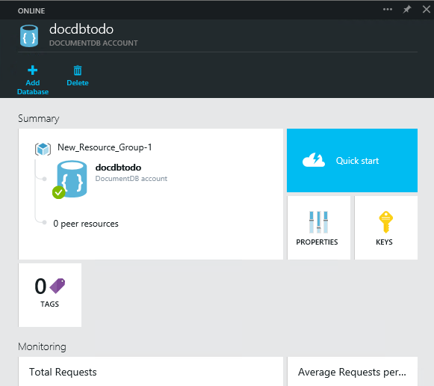
DocumentDB Account Blade
The account blade provides you with essential information about your service
Click on Quick start to see the latest resources for your service
Notes:
Source: http://azure.microsoft.com/en-us/documentation/articles/documentdb-create-account/

Slide 208
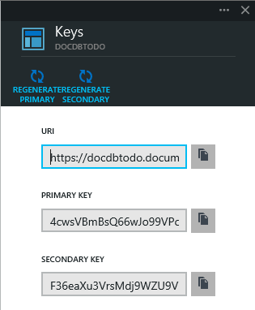
Viewing Service Keys
DocumentDB includes primary and secondary keys for rolling key updates
Notes:
Source: http://azure.microsoft.com/en-us/documentation/articles/documentdb-create-account/

Slide 209
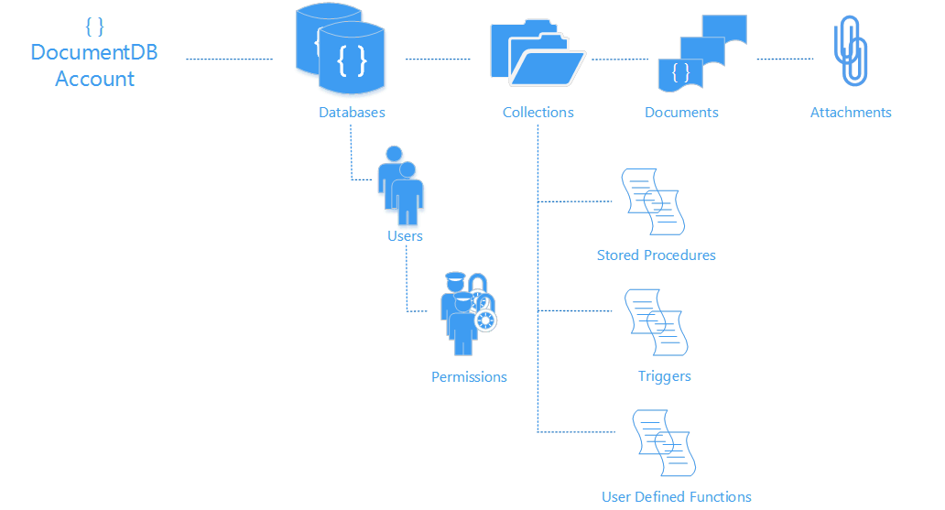
The Basics
Resource model
Entities addressable by logical URI
Partitioned for scale out
Replicated for high availability
Entities represented as JSON
Accounts scale out through addition of capacity units
Interaction model
RESTful interaction over HTTP
HTTP and TCP connectivity
Standard HTTP verbs and semantics
Development
.Net, Node, Python, Java and JavaScript clients
SQL for query expression, .Net LINQ
JavaScript for server-side app logic
/dbs/{id}
/colls/{id}
/docs/{id}
/attachments/{id}
/users/{id}
/sprocs/{id}
/permissions/{id}
/triggers/{id}
/functions/{id}
https://myaccountname.documents.azure.net/dbs/{id}/colls/{id}/docs/{id}
Notes:
Source: http://azure.microsoft.com/en-us/documentation/articles/documentdb-resources/
As the following diagram illustrates, the DocumentDB resource model consists of sets of resources under a database account, each addressable via a logical and stable URI. A set of resources is referred to as a feed in this article.
Hierarchical resource model under a database account
To start working with resources, you must create a DocumentDB database account using your Azure subscription.
A database account can consist of a set of databases, each containing multiple collections, each of which in-turn contain stored procedures, triggers, UDFs, documents and related attachments. A database also has associated users, each with a set of permissions to access collections, stored procedures, triggers, UDFs, documents or attachments. While databases, users, permissions and collections are system-defined resources with well-known schemas, documents and attachments contain arbitrary, user defined JSON content.
Database account. A database account is associated with one or more capacity units representing provisioned document storage and throughput, a set of databases and blob storage. You can create one or more database accounts using your Azure subscription.
Database. A database is a logical container of document storage partitioned across collections. It is also a users container.
User. The logical namespace for scoping/partitioning permissions.
Permission. An authorization token associated with a user for authorized access to a specific resource.
Collection. A collection is a container of JSON documents and the associated JavaScript application logic.
Stored Procedure. Application logic written in JavaScript which is registered with a collection and transactionally executed within the database engine.
Trigger. Application logic written in JavaScript modeling side effects associated with insert, replace or delete operations.
UDF. A side effect free, application logic written in JavaScript. UDFs enable you to model a custom query operator and thereby extend the core DocumentDB query language.
Document. User defined (arbitrary) JSON content. By default, no schema needs to be defined nor do secondary indices need to be provided for all the documents added to a collection.
Attachment. Attachment are special documents containing references and associated metadata for external blob/media. The developer can choose to have the blob managed by DocumentDB or store it with an external blob service provider such as OneDrive, Dropbox, etc.

Slide 210
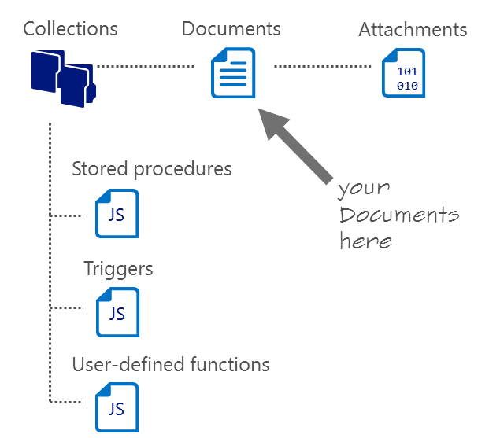
DocumentDB Collections
Collections != tables
Unit of partitioning
Transaction boundary
No enforced schema, flexible
Queried or updated stay together in one collection -
Size of 10 Gb
Notes:
Source: http://azure.microsoft.com/en-us/documentation/articles/documentdb-resources/
A DocumentDB collection is a container for your JSON documents. A collection is also a unit of scale for transactions and queries. You can scale out a DocumentDB database by adding more collections. If your application needs to scale more, you can provision more SSD backed document storage (and throughput) and distribute it across the collections of one or more databases under your database account.

Slide 211
DocumentDB JSON Documents
{
“locations”:
[
{“country”: “Germany”, “city”: “Berlin”},
{“country”: “France”, “city”: “Paris”},
],
“headquarter”: “Belgium”,
“exports”:[{“city”; “Moscow”},{“city: ”Athens”}]
};
JSON document as tree
JSON
Intersection of most modern type systems
JSON values
Self-describable, self-contained values
Do not have behavior, polymorphism, inheritance, access, and visibility rules”
Are trivially serialized to/from text
DocumentDB makes a deep commitment to JSON for storage, indexing, query, and JavaScript execution
Locations
Headquarter
Exports
0
1
Belgium
0
1
Country
City
Country
City
City
City
Germany
Berlin
France
Paris
Moscow
Athens
Notes:
Source: http://azure.microsoft.com/en-us/documentation/articles/documentdb-resources/#documents
You can insert, replace, delete, read, enumerate and query arbitrary JSON documents in a collection. DocumentDB does not mandate any schema and does not require secondary indexes in order to support querying over documents in a collection.
Being a truly open database service, DocumentDB does not invent any specialized data types (e.g. date time) or specific encodings for JSON documents. Note that DocumentDB does not require any special JSON conventions to codify the relationships among various documents; the SQL query language of DocumentDB provides very powerful hierarchical and relational query operators to query and project documents without any special annotations or need to codify relationships among documents using distinguished properties.
As with all other resources, documents can be created, replaced, deleted, read, enumerated and queried easily using either REST APIs or any of the client SDKs. Deleting a document instantly frees up the quota corresponding to all of the nested attachments. The read consistency level of documents follows the consistency policy on the database account. This policy can be overridden on a per-request basis depending on data consistency requirements of your application. When querying documents, the read consistency follows the indexing mode set on the collection. For “consistent”, this follows the account’s consistency policy.

Slide 212
DocumentDB JSON Documents
value
string
numbers
JSON serializable values
(aka JSON Infoset)
object
array
JSON
true
false
null
JavaScript Object Literals
object
{
string
:
value
}
,
array
{
value
}
,
Notes:
Reference: http://en.wikipedia.org/wiki/JSON
Data types, syntax and example
JSON's basic types are:
Number — a signed decimal number that may contain a fractional part and may use exponential E notation. JSON does not allow non-numbers like NaN, nor does it make any distinction between integer and floating-point. (Even though JavaScript uses a double-precision floating-point format for all its numeric values, other languages implementing JSON may encode numbers differently)
String — a sequence of zero or more Unicode characters. Strings are delimited with double-quotation marks and support a backslash escaping syntax.
Boolean — either of the values true or false
Array — an ordered list of zero or more values, each of which may be of any type. Arrays use square bracket notation with elements being comma-separated.
Object — an unordered collection of name/value pairs where the names (also called keys) are strings. Since objects are intended to represent associative arrays,^{[10]} it is recommended, though not required,^{[11]} that each key is unique within an object. Objects are delimited with curly brackets and use commas to separate each pair, while within each pair the colon ':' character separates the key or name from its value.
null — An empty value, using the word null
JSON generally ignores any whitespace around or between syntactic elements (values and punctuation, but not within a string value). However JSON only recognizes four specific whitespace characters: the space, horizontal tab, line feed, and carriage return. JSON does not provide or allow any sort of comment syntax.

Slide 213
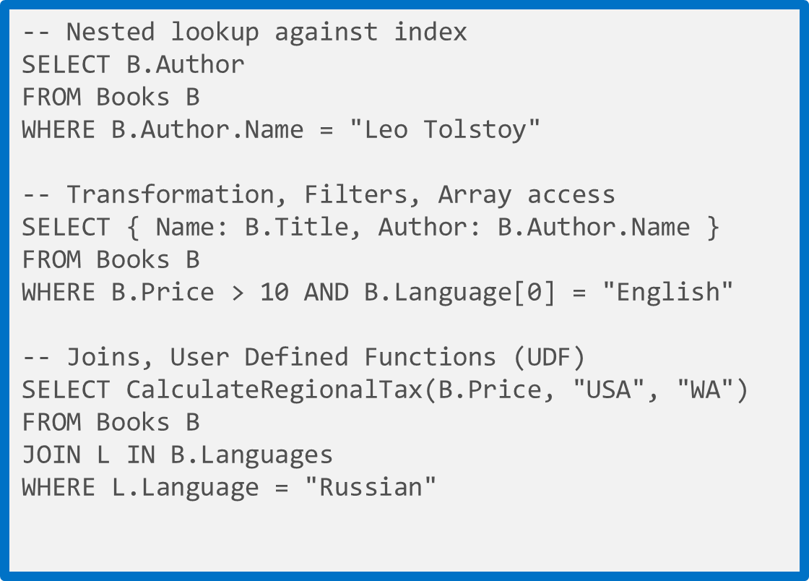
Rich Query Over JSON Data
Query JSON data without specifying secondary indices or constructing views
No forced, pre-defined indices allow for differentiated querying
Native JavaScript transactional processing
Easy integration with web platforms and tools
Familiar SQL-based query language
Query over multiple documents using familiar commands
Notes:
All the data that is brought into the database is automatically indexed and is immediately queryable. No secondary indexes are necessary. You use a SQL query grammar which will be familiar to customers. In addition to querying, DocDB supports JavaScript transaction processing. The best way to think about this is JavaScript is to DocDB as T-SQL is to SQL Server. With JavaScript, you can run server side logic in the form of stored procedures, triggers, and user-defined functions. These run as atomic transactions just like in relational stores, so if something fails halfway through, the data is rolled back to before the transaction began.

Slide 214
Rich Query Over JSON Data
-- Nested lookup against index
SELECT B.Author
FROM Books B
WHERE B.Author.Name = "Leo Tolstoy"
-- Transformation, Filters, Array access
SELECT { Name: B.Title, Author: B.Author.Name }
FROM Books B
WHERE B.Price > 10 AND B.Language[0] = "English"
-- Joins, User Defined Functions (UDF)
SELECT CalculateRegionalTax(B.Price, "USA", "WA")
FROM Books B
JOIN L IN B.Languages
WHERE L.Language = "Russian"
LINQ for .NET developers and a “document oriented“ SQL grammar for traditional SQL developers
Extend query execution through application-supplied JavaScript UDFs
Supported SQL features; predicates, iterations (arrays), sub-queries, logical operators, UDFs, intra-document JOINs, or JSON transforms
Notes:
Source: http://azure.microsoft.com/en-us/documentation/articles/documentdb-sql-query/
Microsoft Azure DocumentDB supports querying documents using SQL (Structured Query Language) over hierarchical JSON documents. DocumentDB is truly schema-free. By virtue of its commitment to the JSON data model directly within the database engine, it provides automatic indexing of JSON documents without requiring explicit schema or creation of secondary indexes. While designing the query language for DocumentDB we had two goals in mind:
Embrace SQL – Instead of inventing a new query language, we wanted to embrace the SQL language. After all, SQL is one of the most familiar and popular query languages. DocumentDB SQL query language provides a formal programming model for rich queries over JSON documents.
Extend SQL – As a JSON document database capable of executing JavaScript directly in the database engine, we wanted to use JavaScript's programming model as the foundation for our SQL query language. The DocumentDB SQL query language is rooted in JavaScript's type system, expression evaluation, and function invocation. This in-turn provides a natural programming model for relational projections, hierarchical navigation across JSON documents, self joins, and invocation of user defined functions (UDFs) written entirely in JavaScript, among other features.
We believe that these capabilities are key to reducing the friction between the application and the database and are crucial for developer productivity.

Slide 215
Simple Predicate Query
Var company1= { “locations” : [
{“country”: “Germany”, “city”: “Berlin”},
{“country”: “France”, “city”: “Paris”},
], “headquarter”: “Belgium”, “exports”: [
{ “city”; “Moscow” },{ “city: ”Athens” }]
};
Var company2= { “locations” :
[{“country”: “Germany”, “city”: “Bonn”, revenue”: 200 } ], “headquarter”: “Italy”, “exports”: [ { “city”; “Berlin” },{ “dealers”: [{“name”: “Hans”}] }, {city”: ”Athens” }]
};
Locations
Headquarter
Exports
Locations
Headquarter
Exports
0
Italy
0
1
0
1
Belgium
0
1
Country
City
Revenue
City
Dealers
City
Country
City
Country
City
City
City
Germany
Bonn
200
Berlin
Name
Athens
Germany
Berlin
France
Paris
Moscow
Athens
Hans
SQL | SELECT * FROM company C WHERE C.headquarter = 'Belgium'
Results | [ { "locations": [{ "country": "Germany", "city": "Berlin" },{ "country": "France", "city": "Paris" }], "headquarter": "Belgium", "exports": [{ "city": "Moscow" },{ "city": "Athens" } ] }]

Slide 216
Iteration Query
Var company1= { “locations” : [
{“country”: “Germany”, “city”: “Berlin”},
{“country”: “France”, “city”: “Paris”},
], “headquarter”: “Belgium”, “exports”: [
{ “city”; “Moscow” },{ “city: ”Athens” }]
};
Var company2= { “locations” :
[{“country”: “Germany”, “city”: “Bonn”, revenue”: 200 } ], “headquarter”: “Italy”, “exports”: [ { “city”; “Berlin” },{ “dealers”: [{“name”: “Hans”}] }, {city”: ”Athens” }]
};
Locations
Headquarter
Exports
Locations
Headquarter
Exports
0
Italy
0
1
0
1
Belgium
0
1
Country
City
Revenue
City
Dealers
City
Country
City
Country
City
City
City
Germany
Bonn
200
Berlin
Name
Athens
Germany
Berlin
France
Paris
Moscow
Athens
Hans
SQL | SELECT * FROM company C WHERE C.headquarter = 'Belgium'
Results | [ {"country": "Germany"}, {"country": "France"}, {"country": "Germany"} ]

Slide 217
Querying Array with Predicates
Var company1= { “locations” : [
{“country”: “Germany”, “city”: “Berlin”},
{“country”: “France”, “city”: “Paris”},
], “headquarter”: “Belgium”, “exports”: [
{ “city”; “Moscow” },{ “city: ”Athens” }]
};
Var company2= { “locations” :
[{“country”: “Germany”, “city”: “Bonn”, revenue”: 200 } ], “headquarter”: “Italy”, “exports”: [ { “city”; “Berlin” },{ “dealers”: [{“name”: “Hans”}] }, {city”: ”Athens” }]
};
Locations
Headquarter
Exports
Locations
Headquarter
Exports
0
Italy
0
1
0
1
Belgium
0
1
Country
City
Revenue
City
Dealers
City
Country
City
Country
City
City
City
Germany
Bonn
200
Berlin
Name
Athens
Germany
Berlin
France
Paris
Moscow
Athens
Hans
SQL | SELECT location.country FROM location IN company.locations WHERE location.city = 'Berlin'
Results | [ {"country": "Germany"} ]

Slide 218
Query with Logical Operators
Var company1= { “locations” : [
{“country”: “Germany”, “city”: “Berlin”},
{“country”: “France”, “city”: “Paris”},
], “headquarter”: “Belgium”, “exports”: [
{ “city”; “Moscow” },{ “city: ”Athens” }]
};
Var company2= { “locations” :
[{“country”: “Germany”, “city”: “Bonn”, revenue”: 200 } ], “headquarter”: “Italy”, “exports”: [ { “city”; “Berlin” },{ “dealers”: [{“name”: “Hans”}] }, {city”: ”Athens” }]
};
Locations
Headquarter
Exports
Locations
Headquarter
Exports
0
Italy
0
1
0
1
Belgium
0
1
Country
City
Revenue
City
Dealers
City
Country
City
Country
City
City
City
Germany
Bonn
200
Berlin
Name
Athens
Germany
Berlin
France
Paris
Moscow
Athens
Hans
SQL | SELECT location.country FROM location IN company.locations WHERE location.city='Bonn' AND location.revenue >100
Results | [ {"country": "Germany"} ]

Slide 219
Query with UDFs
Var company1= { “locations” : [
{“country”: “Germany”, “city”: “Berlin”},
{“country”: “France”, “city”: “Paris”},
], “headquarter”: “Belgium”, “exports”: [
{ “city”; “Moscow” },{ “city: ”Athens” }]
};
Var company2= { “locations” :
[{“country”: “Germany”, “city”: “Bonn”, revenue”: 200 } ], “headquarter”: “Italy”, “exports”: [ { “city”; “Berlin” },{ “dealers”: [{“name”: “Hans”}] }, {city”: ”Athens” }]
};
Locations
Headquarter
Exports
Locations
Headquarter
Exports
0
Italy
0
1
0
1
Belgium
0
1
Country
City
Revenue
City
Dealers
City
Country
City
Country
City
City
City
Germany
Bonn
200
Berlin
Name
Athens
Germany
Berlin
France
Paris
Moscow
Athens
Hans
SQL | SELECT GermanTax(location) FROM location in company.locations
Results | [ {"country": "Germany", "city":"Bonn", "tax":50}, {"country": "Germany", "city":"Berlin", "tax":0}, ]
function GermanTax(income) {
if(income < 1000) return income * 0.1;
else if(income < 10000) return income * 0.2;
return income * 0.4;
}

Slide 220
Query Performance – Pagination
When performing a bulk read of documents or issuing a query, the server returns results in a segmented fashion if the result set is too large.
In order to reduce round-trips, clients may override the page size.
Bounded execution time of 5 seconds per batch
Default page size is 100 (server returns results in chunks of at most 100)
Desired page size can be specified:
Use x-ms-max-item-count request header
Use FeedOptions.MaxItemCount property

Slide 221
.NET SQL Parameterization in DocumentDB
IQueryable<Book>
queryable = client.CreateDocumentQuery<Book>(
collectionSelfLink,
new SqlQuerySpec
{
QueryText = "SELECT * FROM books b WHERE (b.Author.Name = @name)",
Parameters = new SqlParameterCollection()
{
new SqlParameter( "@name",
"Herman Melville")
}
}
);
SQL parameters use the familiar @ notation borrowed from T-SQL.
Parameter values can be any valid JSON values (strings, numbers, Booleans, null, even arrays or nested JSON).
Since DocumentDB is schema-less, parameters are not validated against any type.
Supply additional parameters by adding SqlParameters to the SqlParameterCollection.
Notes:
Source: http://blogs.msdn.com/b/documentdb/archive/2015/01/15/announcing-sql-parameterization-in-documentdb.aspx
We are pleased to announce support for parameterized SQL queries in the Azure DocumentDB REST API and SDKs. Using this feature, you can now write parameterized SQL queries. Parameterized SQL provides robust handling and escaping of user input, preventing accidental exposure of data through “SQL injection” *.
Let's take a look at a sample using the .NET SDK; In addition to plain SQL strings and LINQ expressions, we've added a new SqlQuerySpec class that can be used to build parameterized queries. Here's a sample that queries a "Books" collection with a single user supplied parameter for author name.

Slide 222
Parameterized Query with User-Defined Function
// User Defined Function
function tax(doc) {
// Use simple formula to compute the tax: use income multiplied by factor based on country of headquarters.
var factor =
doc.headquarters == "USA" ? 0.35 :
doc.headquarters == "Germany" ? 0.3 :
doc.headquarters == "Russia" ? 0.2 :
0;
// Check for bad data.
if (factor == 0)
{
throw new Error("Unsupported country: " +
doc.headquarters);
}
// Use simple formula and return.
return doc.income * factor;
}
// Execute UDF with additional condition
var results = client.CreateDocumentQuery<dynamic>(colSelfLink, string.Format("SELECT r.name AS company, Tax(r) AS tax FROM root r WHERE r.type='Company'", udfId));
The complexity of a query impacts the request units consumed for an operation.
Number of predicates
More predicates result in a larger request charge.
Additional predicates can help if they result in narrowing the result set.
Use of user-defined functions (UDFs)
To take advantage of indexing, include at least one filter against an indexed property.
Tip: For all operations, the cost of any given request can be inferred by inspecting the x-ms-request-charge response header.
Notes:
Source: http://azure.microsoft.com/en-us/documentation/articles/documentdb-programming/#udf
User-defined functions
User-defined functions (UDFs) are used to extend the DocumentDB SQL query language grammar and implement custom business logic. They can only be called from inside queries. They do not have access to the context object and are meant to be used as compute-only JavaScript. Therefore, UDFs can be run on secondary replicas of the DocumentDB service.

Slide 223
REST SQL Parameterization
POST https://contosomarketing.documents.azure.com/dbs/XP0mAA==/colls/XP0mAJ3H-AA=/docs
HTTP/1.1 x-ms-documentdb-isquery: True
x-ms-date: Mon, 18 Aug 2014 13:05:49 GMT
authorization: type%3dmaster%26ver%3d1.0%26sig%3dkOU%2bBn2vkvIlHypfE8AA5fulpn8zKjLwdrxBqyg0YGQ%3d
x-ms-version: 2014-08-21
Accept: application/json
Content-Type: application/query+json
Host: contosomarketing.documents.azure.com
Content-Length: 50
{
"query": "SELECT * FROM books b WHERE
(b.Author.Name = @name)",
"parameters":
[
{
"name": "@name",
"value": "Herman Melville“
}
]
}
Specify the Content-Type Header as application/query+json and the query as JSON in the body.
Notes:
Source: http://blogs.msdn.com/b/documentdb/archive/2015/01/15/announcing-sql-parameterization-in-documentdb.aspx
The DocumentDB REST API also natively supports parameterization. The .NET sample shown above translates to the following REST API call. To use parameterized queries, you need to specify the Content-Type Header as application/query+json and the query as JSON in the body, as shown

Slide 224
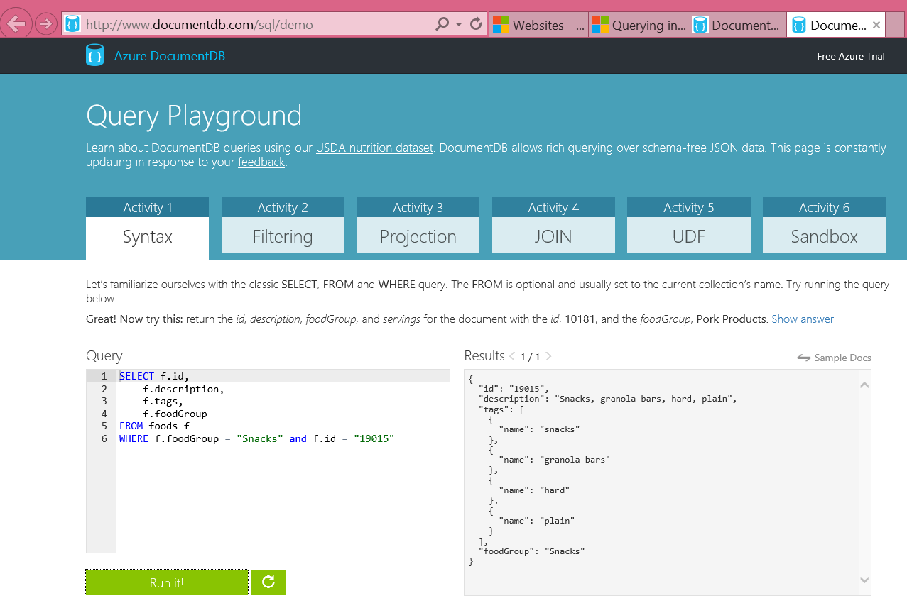
DocumentDB Query Playground
http://www.documentdb.com/sql/demo
Test out sample queries or write your own against the dataset
Notes:
Source: http://www.documentdb.com/sql/demo
Learn about DocumentDB queries using our USDA nutrition dataset. DocumentDB allows rich querying over schema-free JSON data. This page is constantly updating in response to your feedback.

Slide 225
Query with SQL
http://www.documentdb.com/sql/demo
Notes:
See http://azure.microsoft.com/en-us/documentation/articles/documentdb-sql-query/ for demo scenario
Video of sequence at http://azure.microsoft.com/en-us/documentation/videos/dataexposedqueryingdocumentdb/

Slide 226
Create, Get, Replace, Delete Overview

Slide 227
Programmability
client = new DocumentClient(new Uri(endpointUrl), authKey);
Database database = await client.CreateDatabaseAsync(new Database{Id = “myNewDatabase”});
DocumentCollection collection = await client.CreateDocumentCollectionAsync(database.SelfLink, new DocumentCollection{Id = “Pages"});
Page page = new Page
{
Id = "Sample",
Title = "About Paris",
Language = new Language { Name = "English" },
Author = new Author { Name = "Don” },
Content = "Don's document in DocDB is a valid JSON document",
PageViews = 10000,
Topics = new Topic[] {
new Topic { Title = "History" },
new Topic { Title = "Places to see" }}
};
ResourceResponse<Document> resp = await client.CreateDocumentAsync(collection.DocumentsLink, page);
Broad language and platform support
REST/HTTP APIs
C#, Node.js, JavaScript and Python SDKs for Public Preview
SDKs open sourced through GitHub
C# Client SDK
Supports gateway and direct connectivity
Async APIs for all operations
HTTP and TCP transports available
POCOs, inherited document types and dynamics
LINQ provider for query execution

Slide 228
Create Document: POST
POST https://contosomarketing.documents.azure.com/dbs/ehszAA==/colls/ehszALxRRgA=/docs HTTP/1.1
Host: contosomarketing.documents.azure.com
{"id":"Book2","Title":"About Seattle","Language":{"id":"English"},"Author":{"id":"Fred","Location":{"City":"Seattle","Country":"United States"}},"Synopsis":"Seattle, the largest city in the U.S. Pacific Northwest...","Pages":400,"Topics":[{"Title":"History of Seattle"},{"Title":"Places to see in in Seattle"}]}
Create a new document.
By default a document is automatically indexed.
If automatic indexing is turned off at the collection level, you can manually include or exclude documents from being indexed by using the x-ms-indexing-directive header during POST.
Notes:
Source: https://msdn.microsoft.com/en-us/library/azure/dn803948.aspx
A new document can be created by executing an HTTPS POST request against the docs URI resource path.
Documents are automatically indexed. If automatic indexing is turned off at the collection level, documents can be manually included or excluded from being indexed by using the x-ms-indexing-directive header during the POST operation .Documents must adhere to size limits, as specified in DocumentDB Limits.

Slide 229
Retrieve Document: GET
GET https://contosomarketing.documents.azure.com/dbs/-yI8AA==/colls/-yI8AKNuyAA=/docs/-yI8AKNuyAANAAAAAAAAAA== HTTP/1.1
Host: contosomarketing.documents.azure.com
RESPONSE
{"Title":"About St. Louis","Language":{"id":"English"},"id":"ISBN0-8800-1599-1","_rid":"-yI8AKNuyAANAAAAAAAAAA==","_ts":1408333905,"_self":"dbs\/-yI8AA==\/colls\/-yI8AKNuyAA=\/docs\/-yI8AKNuyAANAAAAAAAAAA==\/","_etag":"00005c00-0000-0000-0000-53f178510000","_attachments":"attachments\/"}
Retrieve user-defined JSON elements and system properties of the document.
Read consistency can be overridden to meet the needs of the application. The override is set per GET operation in the x-ms-consistency-level header.
Consistency override can be the same or weaker than the level that was set during account creation.
Notes:
Source: https://msdn.microsoft.com/en-us/library/azure/dn803957.aspx
Performing a GET operation on a specific document resource retrieves the user defined JSON elements and system properties of the document. While consistency level is defined at the database account level during account creation, read consistency can be overridden to suffice the need of the application. The override is set per GET operation by setting the x-ms-consistency-level header to the desired level. The rule of thumb is that the consistency override can only be the same or weaker than the level that was set during account creation. For instance, if during account creation the consistency level was set to Session, the override cannot be Strong or Bounded. For information on consistent level, see Consistency levels in DocumentDB.

Slide 230
Replace Document: PUT
PUT https://contosomarketing.documents.azure.com/dbs/ehszAA==/colls/ehszALxRRgA=/docs/XP0mAJ3H-AACAAAAAAAAAA== HTTP/1.1
Host: contosomarketing.documents.azure.com
{"id":"ISBDN 0-1231-1231-1","Title":"About Seattle","Language":{"id":"English"},"Author":{"id":"Fred","Location":{"City":"Seattle","Country":"United States"}},"Synopsis":"Seattle, the largest city in the U.S. Pacific Northwest...","Pages":400,"Topics":[{"Title":"History of Seattle"},{"Title":"Places to see in in Seattle"}]}
Replace the entire document resource on a specific document.
All user settable properties, including the id and the user-defined JSON elements, must be submitted in the body to perform the replacement.
Any element omissions will result in unintended data loss as this operation is a full replace operation.
The x-ms-indexing-directive header can be set and submitted for the operation to include or exclude the document from being indexed.
Notes:
Source: https://msdn.microsoft.com/en-us/library/azure/dn803947.aspx
Performing a PUT operation on a specific document resource replaces the entire document resource. All user settable properties, including the id, and the user defined JSON elements must be submitted in the body to perform the replacement. Any element omissions result in unintended data loss as this operation is a full replace operation. The x-ms-indexing-directive header can be set and submitted for the operation to include or exclude the document from being indexed.

Slide 231
Delete Document
DELETE https://contosomarketing.documents.azure.com/dbs/XP0mAA==/colls/XP0mAJ3H-AA=/docs/XP0mAJ3H-AAFAAAAAAAAAA== HTTP/1.1
Accept: application/json
Host: contosomarketing.documents.azure.com
RESPONSE
HTTP/1.1 204 No Content
Content-Length: 0
Content-Type: application/json
Content-Location: https://contosomarketing.documents.azure.com/dbs/XP0mAA==/colls/XP0mAJ3H-AA=/docs/XP0mAJ3H-AAFAAAAAAAAAA==
Delete the document resource from the collection.
204 is returned when the delete operation is successful.
404 is returned when the document does not exist (the document may have already been deleted).
Notes:
Source: https://msdn.microsoft.com/en-us/library/azure/dn803952.aspx
Performing a DELETE operation on a specific document resource deletes the document resource from the collection.

Slide 232
DocumentDB Transactions and Indexing

Slide 233
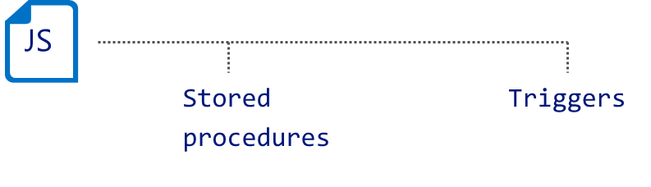
JavaScript Transactions
Transactionally process multiple documents with application-defined stored procedures and triggers
JavaScript as the procedural language
Execution wrapped in an implicit transaction
Preregistered and scoped to a collection
Performed with ACID guarantees
Triggers invoked as pre- or post-operations
Notes:
Source: http://azure.microsoft.com/en-us/documentation/articles/documentdb-programming/#transactions
Transaction in a typical database can be defined as a sequence of operations performed as a single logical unit of work. Each transaction provides ACID guarantees. ACID is a well-known acronym that stands for four properties - Atomicity, Consistency, Isolation and Durability.
Briefly, atomicity guarantees that all the work done inside a transaction is treated as a single unit where either all of it is committed or none. Consistency makes sure that the data is always in a good internal state across transactions. Isolation guarantees that no two transactions interfere with each other – generally, most commercial systems provide multiple isolation levels that can be used based on the application needs. Durability ensures that any change that’s committed in the database will always be present.
In DocumentDB, JavaScript is hosted in the same memory space as the database. Hence, requests made within stored procedures and triggers execute in the same scope of a database session. This enables DocumentDB to guarantee ACID for all operations that are part of a single stored procedure/trigger.

Slide 234
JavaScript Transactions
Stored procedures and triggers
Registered as named, URI addressable, durable resources
Scoped to a DocumentDB collection
JavaScript as a procedural language to express business logic
Language integration
JavaScript throw statement aborts the transaction
Execution
JavaScript runtime is hosted on each replica
Pre-compiled on registration
Entire procedure is wrapped in an implicit database transaction
Execution is fully resource governed and sandboxed
client.executeStoredProcedureAsync
("procs/1234", "MasterChief", "SolidSnake") .then(function (response) { console.log(“success!"); }, function (err) { console.log("Failed to swap!", error); } );
Client
function(playerId1, playerId2) { var collection = getContext().getCollection();
var playersToSwap = collection.filterDocuments(function (document) { return (document.id == playerId1 || document.id == playerId2); }); var player1 = playersToSwap[0], player2 = playersToSwap[1]; var player1ItemTemp = player1.item; player1.item = player2.item; player2.item = player1ItemTemp;
collection.replaceDocument(player1) .then(function() { return collection.replaceDocument(player2); }) .fail(function(error){ throw 'Unable to update players, abort'; }); }
Database
Notes:
Reference: http://azure.microsoft.com/en-us/documentation/articles/documentdb-programming/
DocumentDB’s language integrated, transactional execution of JavaScript lets developers write stored procedures, triggers and user defined functions (UDFs) natively in JavaScript. This allows developers to write application logic which can be shipped and executed directly on the database storage partitions.
This approach of “*JavaScript as a modern day T-SQL*” frees application developers from the complexities of type system mismatches and object-relational mapping technologies. It also has a number of intrinsic advantages that can be utilized to build rich applications:
Procedural Logic: JavaScript as a high level programming language, provides a rich and familiar interface to express business logic. You can perform complex sequences of operations closer to the data.
Atomic Transactions: DocumentDB guarantees the database operations performed inside a single stored procedure or trigger to be atomic. This lets an application combine related operations in a single batch so that either all of them succeed or none do.
Performance: The fact that JSON is intrinsically mapped to the Javascript language type system and is also the basic unit of storage in DocumentDB allows for a number of optimizations like lazy materialization of JSON documents in the buffer pool and making them available on-demand to the executing code. There are more performance benefits associated with shipping business logic to the database:
Batching – Developers can group operations like inserts and submit them in bulk. The network traffic latency cost, and the store overhead to create separate transactions are reduced significantly.
Pre-compilation – DocumentDB precompiles stored procedures, triggers and user defined functions (UDFs) to avoid JavaScript compilation cost for each invocation. The overhead of building the byte code for the procedural logic is amortized to a minimal value.
Sequencing – Many operations need a side-effect (“trigger”) that potentially involves doing one or many secondary store operations. Aside from atomicity, this is more performant when moved to the server.
Encapsulation: Stored procedures can be used to group business logic in one place. This has two advantages:
It adds an abstraction layer on top of the raw data, which enables data architects to evolve their applications independently from the data. This is particularly advantageous when the data is schema-less, due to the brittle assumptions that may need to be baked into the application if they have to deal with data directly.
This abstraction lets enterprises keep their data secure by streamlining the access from the scripts.
The creation and execution of triggers, stored procedure and custom query operators is supported through the REST API, and client SDKs in many platforms including .NET, Node.js and JavaScript.

Slide 235
DocumentDB: Consistency Levels
DocumentDB lets you trade off latency vs. consistency for direct reads and queries
 |  | Data consistency policy
 |  | Strong | Bounded Staleness | Session | Eventual
Indexing mode | Lazy | Eventual | Eventual | Eventual | Eventual
 | Consistent | Strong | Bounded Staleness | Session | Eventual
Notes:
Source: http://azure.microsoft.com/en-us/documentation/articles/documentdb-consistency-levels/
Query Consistency
By default, for user defined resources, the consistency level of the queries is the same as the reads. By default, the index is updated synchronously on each insert, replace, or delete of a document to the collection. This enables the queries to honor the same consistency level as that of the document reads. While DocumentDB is write optimized and supports sustained volumes of document writes along with synchronous index maintenance and serving consistent queries, you can configure certain collections to update their index lazily. Lazy indexing further boosts the write performance and is ideal for bulk ingestion scenarios when a workload is primarily read-heavy.

Slide 236
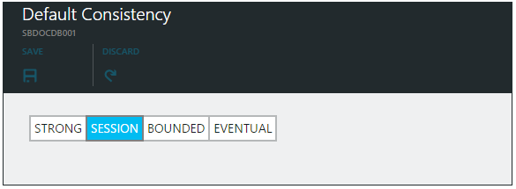
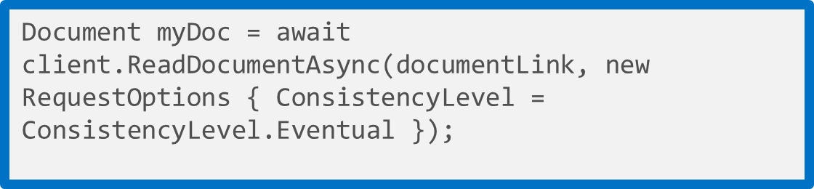
DocumentDB: Consistency Levels
Strong: Guarantees that a write is only visible after it is committed durably by the majority quorum of replicas and reads are always acknowledged by the majority read quorum
Session: Provides predictable read consistency for a session while offering the low latency writes; reads are also low latency as a read will be served by a single replica
Bounded Staleness: Bounded Staleness consistency guarantees the total order of propagation of writes but reads may lag writes by N seconds or operations (configurable)
Eventual: Eventual consistency is the weakest form of consistency wherein a client may get the values which are older than the ones it had seen before, over time
Notes:
Source: http://azure.microsoft.com/en-us/documentation/articles/documentdb-consistency-levels/
Developers are often faced with the challenge of choosing between the two extremes of strong and eventual consistency. The reality is that there are multiple consistency click-stops between these two extremes. In most real world scenarios, applications benefit from making fine grained trade-offs between consistency, availability, and latency. DocumentDB offers four well-defined consistency levels with associated performance levels. This allows application developers to make predictable consistency-availability-latency trade-offs.
All system resources, including database accounts, databases, collections, users, and permissions are always strongly consistent for reads and queries. The consistency levels apply only to the user defined resources. For queries and read operations on user defined resources, including documents, attachments, stored procedures, triggers, and UDFs, DocumentDB offers four distinct consistency levels:
Strong
Bounded staleness
Session
Eventual
These granular, well-defined consistency levels allow you to make sound trade-offs between consistency, availability, and performance. These consistency levels are backed by predictable performance levels ensuring consistent results for your application.

Slide 237
Consistency Levels and Performance
Write operations
Consistency level changes impact request latency
Stronger consistency levels result in higher write latencies
Read operations
Consistency level changes impact throughput
Weaker consistency levels result in higher read throughput
Tip: You can lower the consistency level of a specific read or query request by specifying [x-ms-consistency-level] request header or by using RequestOptions in the SDKs.

Slide 238
Indexing
value
The “write” index for consistent queries
Highly concurrent, lock free, log structured indexing technology developed with Microsoft Research
Optimized for SSD
Resource governed for tenant isolation
Automatic indexing of JSON documents without requiring schema or secondary indices. Configurable via:
Modes
Policies
Paths
Types
string
numbers
object
array
true
false
null
object
{
string
:
value
}
,
array
{
value
}
,
Notes:
Source: http://azure.microsoft.com/en-us/documentation/articles/documentdb-indexing-policies/
DocumentDB is a true schema-free database. It does not assume or require any schema for the JSON documents it indexes. This allows you to quickly define and iterate on application data models. As you add documents to a collection, DocumentDB automatically indexes all document properties so they are available for you to query. Automatic indexing also allows you to store heterogeneous types of documents.
Automatic indexing of documents is enabled by write optimized, lock free, and log structured index maintenance techniques. DocumentDB supports a sustained volume of fast writes while still serving consistent queries.
The DocumentDB indexing subsystem is designed to support:
· Efficient, rich hierarchical and relational queries without any schema or index definitions.
· Consistent query results while handling a sustained volume of writes. For high write throughput workloads with consistent queries, the index is updated incrementally, efficiently, and online while handling a sustained volume of writes.
· Storage efficiency. For cost effectiveness, the on-disk storage overhead of the index is bounded and predictable.
· Multi-tenancy. Index updates are performed within the budget of system resources allocated per DocumentDB collection.
For most applications, you can use the default automatic indexing policy as it allows for the most flexibility and sound tradeoffs between performance and storage efficiency. On the other hand, specifying a custom indexing policy allows you to make granular tradeoffs between query performance, write performance, and index storage overhead.

Slide 239
Indexing Modes and Policies
Set indexing mode
Indexing modes
Consistent
Default mode
Index updated synchronously on writes
Lazy
Useful for bulk ingestion scenarios
Indexing policies
Automatic
Default
Manual
Can choose to index documents via RequestOptions
IndexingDirective = IndexingDirective.Include
Can read non-indexed documents via selflink
var collection = new DocumentCollection
{
Id = “lazyCollection”
};
collection.IndexingPolicy.IndexingMode = IndexingMode.Lazy;
collection = await client.CreateDocumentCollectionAsync(databaseLink, collection);
Set indexing policy
var collection = new DocumentCollection
{
Id = “manualCollection”
};
collection.IndexingPolicy.Automatic = false;
collection = await client.CreateDocumentCollectionAsync(databaseLink, collection);
Notes:
Source: http://azure.microsoft.com/en-us/documentation/articles/documentdb-indexing-policies/#ConfigPolicy
Configuring the indexing policy of a collection
The following sample shows how to set a custom indexing policy during the creation of a collection, by using the DocumentDB REST API.
Note: The indexing policy of a collection must be specified at the time of creation. Modifying the indexing policy after collection creation is not allowed, but will be supported in a future release of DocumentDB.
Note: By default, DocumentDB indexes all paths within documents consistently with a hash index. The internal Timestamp (_ts) path is stored with a range index.

Slide 240
Indexing Paths and Types
var collection = new DocumentCollection
{
Id = “Orders”
};
collection.IndexingPolicy.IncludedPaths.Add(new IndexingPath
{
IndexType = IndexType.Hash,
Path = "/",
});
collection.IndexingPolicy.IncludedPaths.Add(new IndexingPath
{
IndexType = IndexType.Range,
Path = @"/""shippedTimestamp""/?",
NumericPrecision = 7
});
collection.IndexingPolicy.ExcludedPaths.Add("/\"metaData\"/*");
collection = await client.CreateDocumentCollectionAsync(databaseLink, collection);
Hash Index Type
Supported for strings and numbers
Optimized for equality matches
Range Index Type
Supported for numbers
Optimized for comparison queries
String Index Precision
Default is 3
Numeric Index Precision
Default is 3
Increase for larger number fields (epoch timestamps)
Notes:
Source: http://azure.microsoft.com/en-us/documentation/articles/documentdb-indexing-policies/#ConfigPolicy
Index types and precision
The type or scheme used for index entries has a direct impact on index storage and performance. For a scheme using higher precision, queries are typically faster. However, there is also a higher storage overhead for the index. Choosing a lower precision means that more documents might have to be processed during query execution, but the storage overhead will be lower.
The index precision for values at any path can be between 3 and 7 bytes. Since the same path might have numeric and string values in different documents, these can be controlled separately. In the .NET SDK, these values correspond to the NumericPrecision and StringPrecision properties.
There are two supported kinds of index types: Hash and Range. Choosing an index type of Hash enables efficient equality queries. For most use cases, hash indexes do not need a higher precision than the default value of 3 bytes.
Choosing an index type of Range enables range queries (using >, <, >=, <=, !=). For paths that have large ranges of values, it is recommended to use a higher precision like 6 bytes. A common use case that requires a higher precision range index is timestamps stored as epoch time.
If your use case does not require efficient range queries, then the default of hash indexes offer the best tradeoff of storage and performance. Note that to support range queries, you must specify a custom index policy.

Slide 241
Query and indexing tips
Consider query needs and index policies (index policies are currently immutable)
Understand query costs and limits, and avoid scans
Pre-aggregate where possible
Notes:
Source: http://azure.microsoft.com/en-us/documentation/articles/documentdb-indexing-policies/#performance-tuning
As you evaluate different indexing policy configurations, you should measure the storage and throughput implications of the policy through the DocumentDB APIs.
To check the storage quota and usage of a collection, run a HEAD or GET request against the collection resource, and inspect the x-ms-request-quota and the x-ms-request-usage headers. In the .NET SDK, the DocumentSizeQuota and DocumentSizeUsage properties in ResourceResponse contain these corresponding values.

Slide 242
DocumentDB Service Summary
Unique among NoSQL stores
Developed for the cloud and to be delivered as a service.
Truly query-able and is a native JSON store.
Transactional processing through language integrated JavaScript.
Predictable performance and tunable consistency.
DocumentDB for these development scenarios
Customers building new web and mobile cloud based applications.
Rapid development and high scalability requirements.
Query and processing of user and device-generated data.
Customers using K-V stores needing more query and processing support.
Customers running a document store in virtual machines looking for a managed service.
Notes:
To recap, there are a few key points we want you to take a way from this presentation today.
DocumentDB is unique among NoSQL stores
It was developed and is delivered as a service on Azure
It’s truly schema-free and queryable using SQL
It has transactional processing just like a relational database
It has predictable performance and tunable consistency in the cloud.
Your customers should consider DocumentDB for these use cases
Customers building new web and mobile cloud based applications
Rapid Development and High Scalability Requirements
Query and processing of user and device generated data
Customers using K-V stores needing more query and processing support
Customers running a document store in VMs looking for a fully managed service.
Go talk to your customers, find out where document databases are being explored, trialed, or used in production and tell them about DocumentDB.
.

Slide 243
Build your first DocumentDB app today
Get Started …
Sign up for DocumentDB at http://aka.ms/docdbstart
Access and configure your account through http://portal.azure.com
Download an SDK http://aka.ms/docdbsdks, and build a sample at http://aka.ms/docdbsample
Give Feedback …
Ask questions through the forum http://aka.ms/docdbforum
Suggest an idea and vote up other ideas for DocumentDB http://aka.ms/docdbideas
On twitter @documentdb

Slide 244
HOL4 DocumentDB and Azure Websites

Slide 246
Thank you!
© 2015 Microsoft Corporation. All rights reserved. Microsoft, Windows, Windows Vista and other product names are or may be registered trademarks and/or trademarks in the U.S. and/or other countries.
The information herein is for informational purposes only and represents the current view of Microsoft Corporation as of the date of this presentation. Because Microsoft must respond to changing market conditions, it should not be interpreted to be a commitment on the part of Microsoft, and Microsoft cannot guarantee the accuracy of any information provided after the date of this presentation. MICROSOFT MAKES NO WARRANTIES, EXPRESS, IMPLIED OR STATUTORY, AS TO THE INFORMATION IN THIS PRESENTATION.

Slide 247
Security model
Master key
Access control on resources
User operations
Permission operations
Code execution
Notes:
Master key
A master key is a security token to access all resources for an account. Individuals with the key have read and write access to the all resources in the database account. Use caution when distributing master keys. The primary master key and secondary master key are available in the Keys blade of the Azure Preview portal.
Access control on resources
Access to DocumentDB resources is governed by a master key token or a resource token. The master key token is the all access key token that allows individuals to have full control of DocumentDB resources in a particular account. The master key is created during the creation of an account. There are two sets of master keys, the primary key and the secondary key. The administrator of the account can then exercise key rotation using the secondary key. In addition, the account administrator can also regenerate the keys as needed. For instructions on regenerating and rolling keys, see How to manage a DocumentDB account.
Resource tokens are created when users in a database are set up with access permissions for precise access control on a resource. A permission resource contains a hash resource token specifically constructed with the information regarding the resource path and access type a user has access to. The permission resource token is time bound and the validity period can be overridden. When a permission resource is acted upon on (POST, GET, PUT), a new resource token is generated. For information on permissions and resource tokens, see Operations on DocumentDB Permissions.
All REST operations must include the authorization header with the authorization string in order to interact with a resource.
User operations
The DocumentDB API supports basic CRUD operations on the resources under a database account. A user is a logical namespace for scoping permissions on collections, documents, attachment, stored procedures, triggers and user-defined functions. The user construct lives under a database resource thus cannot cross the database boundary it is under. The user resource is represented by users in the DocumentDB REST resource mode. It is a system resource thus contains a fixed schema.
The top-level topic that outlines the basic CRUD operations on the resources under a DocumentDB database account, that itemizes those resources and describes the URLs used to access them is Azure DocumentDB REST API Reference.
Permission operations
The DocumentDB API supports basic CRUD operations on the resources under a database account. Permission is an authorization token associated with a user for authorized access to a specific resource. It is used to manage access to collections, documents, attachments, stored procedures, triggers and user-defined functions for a particular user. You can associate only one permission to a particular resource for a user. For example, MarketingCollection with _rid xynsa== can only be associated with one permission for user JanetSmith@contoso.com. An attempt to add another permission to MarketingCollection for Janet will result in an error (409 Conflict). There are only two permissionMode, All and Read. All will provide read, write and delete access to a resource. Read is self-explanatory. A resource token is created every time a GET or PUT or POST is performed on a permission. By default, the validity period of a resource token is 1 hour. The validity period can be overridden to up to 5 hours.
Code execution security
JavaScript stored procedures and triggers are sandboxed so that the effects of one script do not leak to the other without going through the snapshot transaction isolation at the database level. The runtime environments are pooled but cleaned of the context after each run. Hence they are guaranteed to be safe of any unintended side effects from each other

